Slide 1
AI Trends and Fun Demos II
Ethan Holland
February 25, 2025 to September 03, 2025

Slide 2
Quick show of hands.
Who was here last time?

Slide 3

Six months have passed…

Slide 4
Let’s review and see what’s happened!

Slide 5
About me
(abbreviated for new audience)

Slide 6
30 Years Transforming Legacy
Companies -> Digital

Slide 7
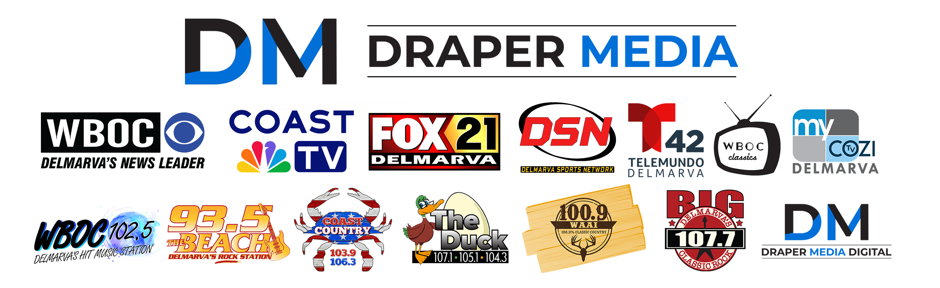
Currently VP Digital At Draper Media
VP Draper Digital Media

Slide 8


Slide 9
English Literature Major
No Computer Science Courses

Slide 10
Fun Adventures Along The Way
In My Career

Slide 11
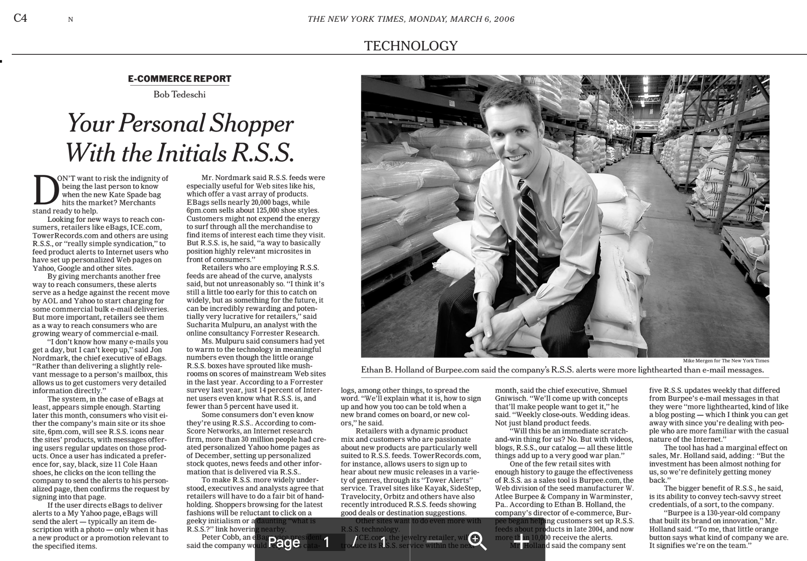

Slide 12
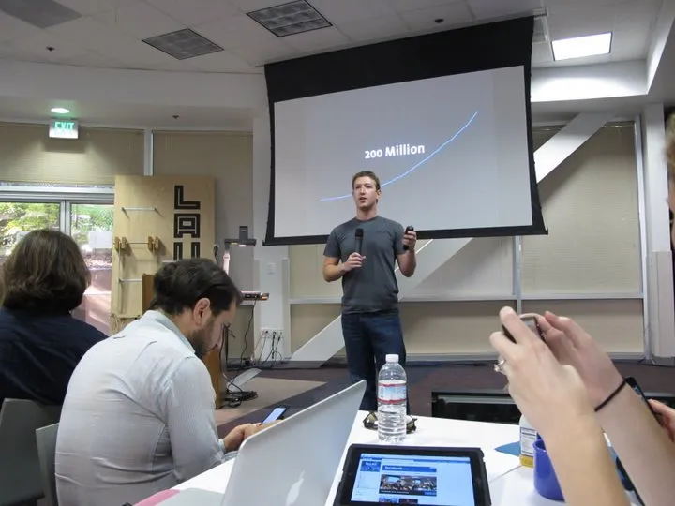
Meetings with Mark Zuckerberg

Slide 13

Keynote speaker at Adobe’s worldwide sales conference

Slide 14
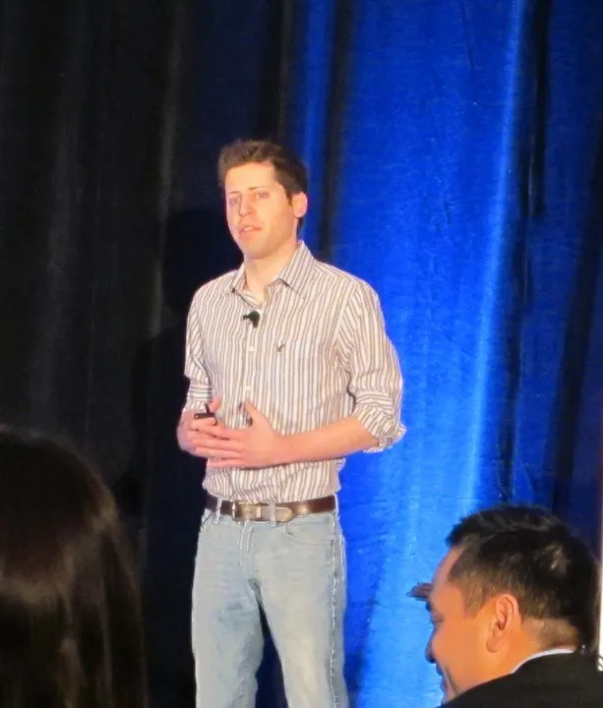
Presented with Sam Altman (long before OpenAI)

Slide 15
Today I’m Simply Myself
Nerdy Friend of Kathleen Schell Obsessive AI Enthusiast!

Slide 16
In October 2023, I launched a weekly AI news blog
Took 54 hours of work to publish one week of AI news
https://ethanbholland.com/category/this-week-in-ai/

Slide 17
Struggled to keep up.
Was six weeks behind for 10 months.
Automated the routine parts using AI.

Slide 18
Now my blog takes only the time needed to read the headlines
(STILL SIX HOURS)
And 15 min/week to post it all.

Slide 19
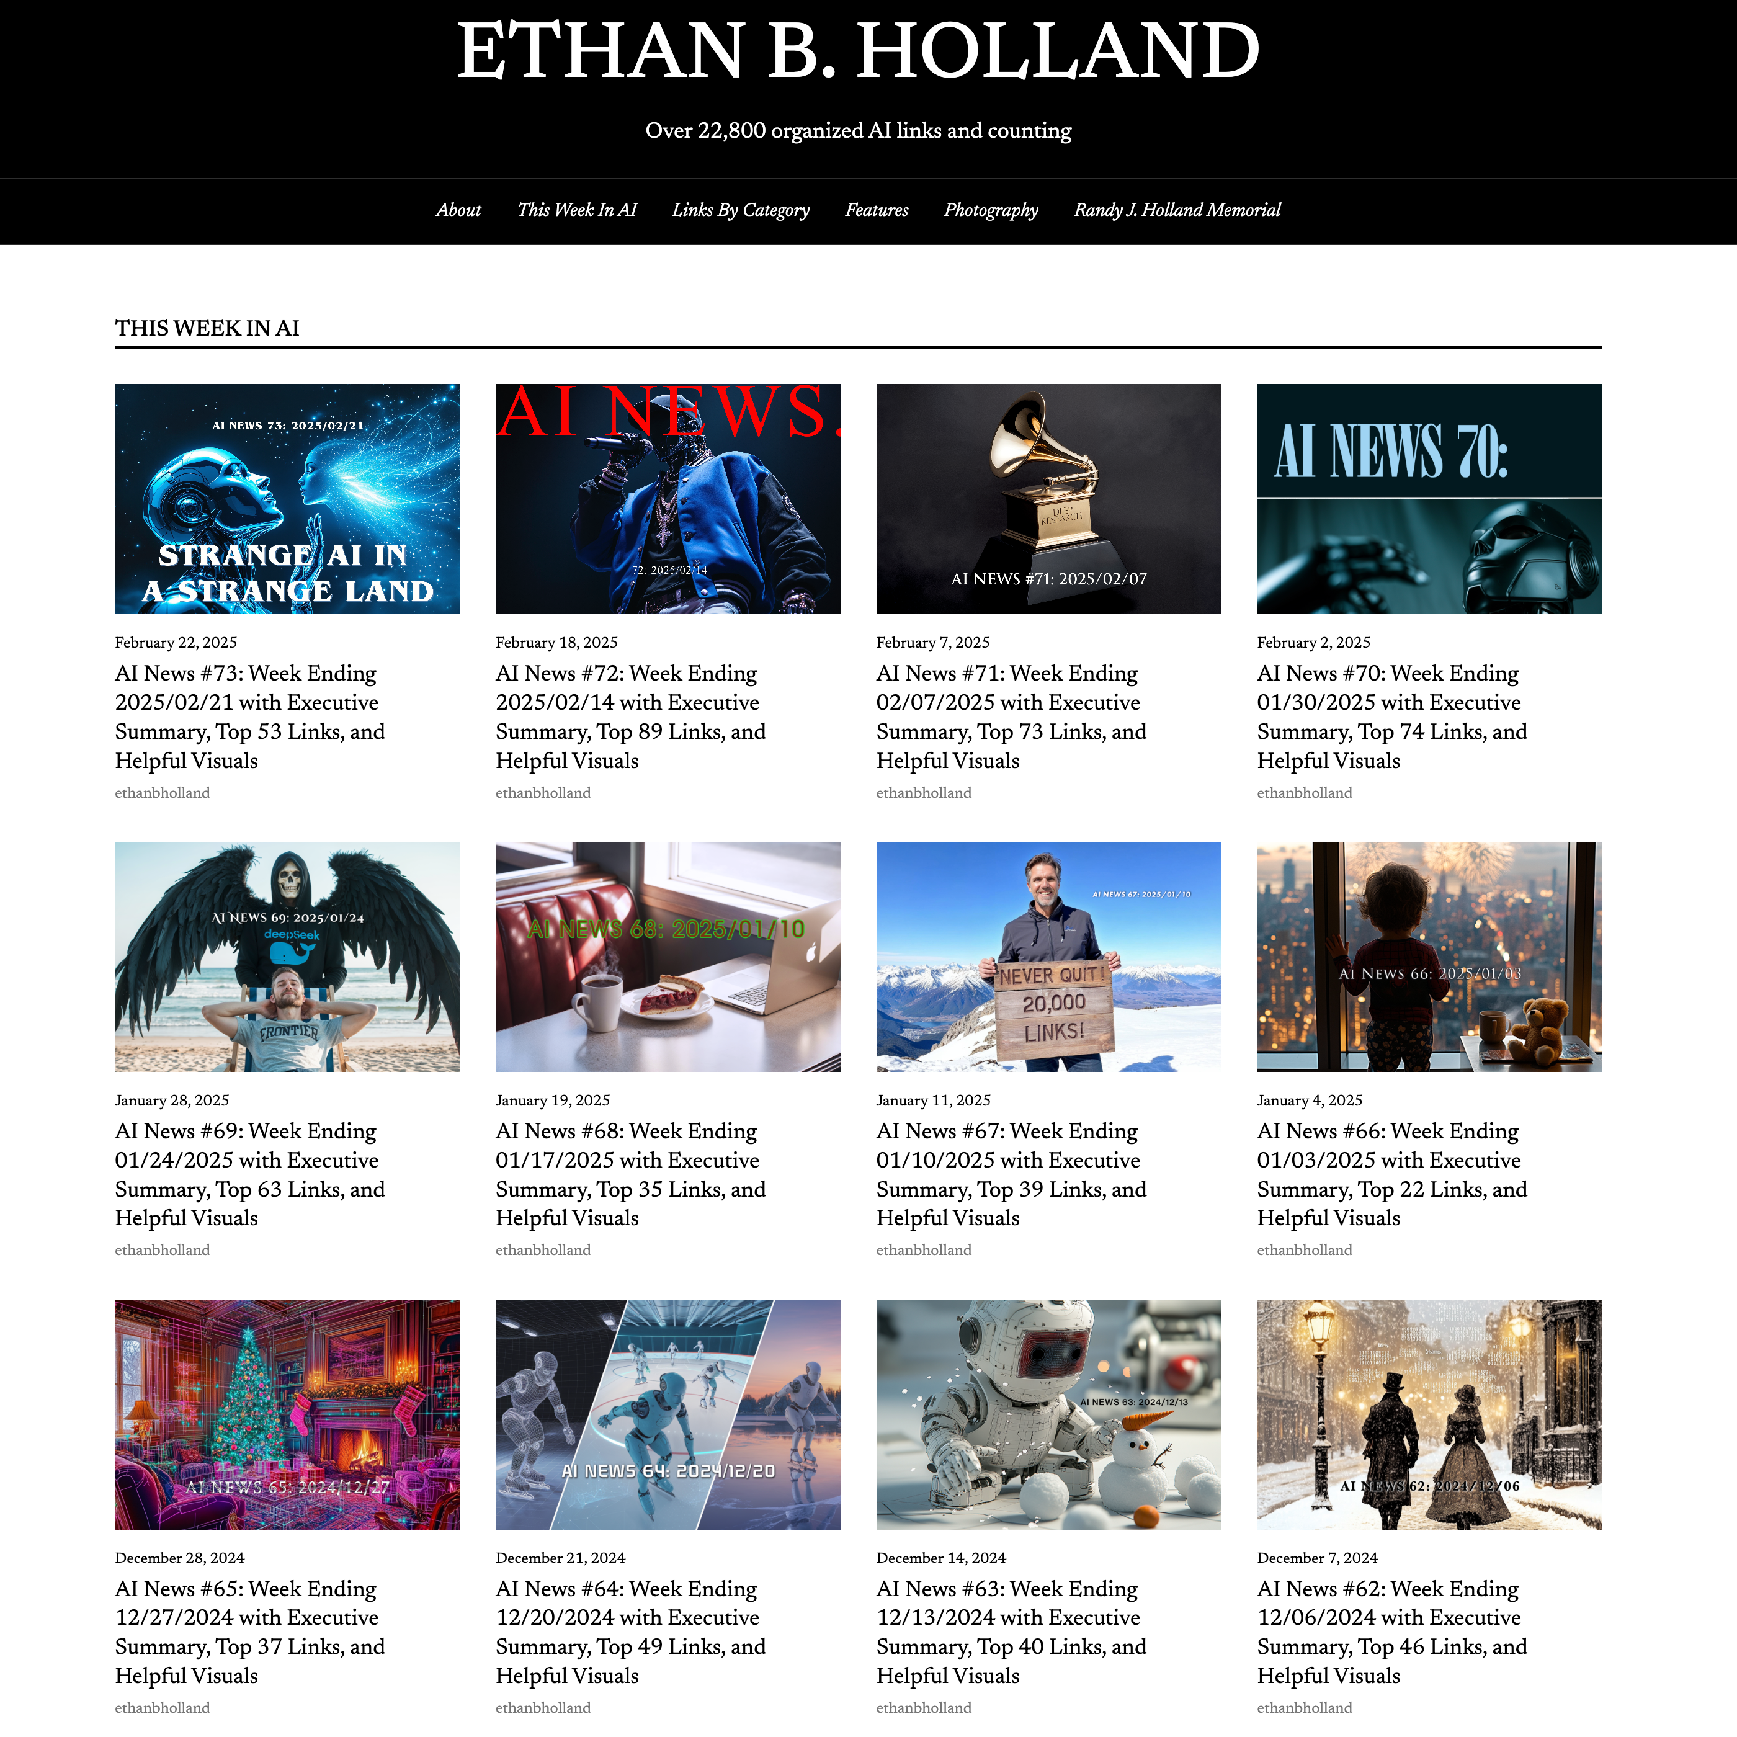
73 weeks. 22,800 links.
97 weeks. 35,600 links.

Slide 20
Today we’ll continue the four AI trends from February…

Slide 21
As we start, here are three guiding principles to remember:

Slide 22
THE SUM is greater than the parts.
Think about how the things we see today will connect.

Slide 23
Always be aware of your mental timetable:
Short term
Mid term
Long term
Otherwise it causes chaos when trying to talk about AI

Slide 24
When possible, use the tool name or technology, not simply “AI”
GPT5, Gemini, Opus 4.1, Grok 4, Llama 4, Mistral, ElevenLabs, HeyGen, Flux, MidJourney, Mistral, Deepseek, Runway, Kling, Viggle, NeRFs, LivePortrait, Gaussian Splats, Diffusion,…

Slide 25
For each trend, I’ll run through in chronological order since February.
I’m putting everything in the slides…
BUT… I’m only reading the text in yellow.
Practice tuning out anything not yellow… and go read it later!
TURN OFF YOUR BRAIN AND RELAX… FLOAT ALONG WITH ME.
HERE’S WHAT’S HAPPENED SINCE FEBRUARY

Slide 26
Before we hit the trends, let’s review AI in general and practice only reading the yellow text…

Slide 27
Usage and General Highlights
February 28, 2025
OpenAI updates GPT 4.5
March 7, 2025
OpenAI Launches GPT-4.5 with Focus on “Human-Like” Interactions
March 21 2025
Meta’s open-source model Llama has hit 1 billion downloads.
April 18, 2025
ChatGPT now has 1 billion weekly active users.
May 02, 2025
Waymo has reached 250,000 weekly paid robotaxi rides across the United States in four cities.
Morgan Stanley forecasts 1 billion humanoid robots by 2050.
May 9, 2025
To test Google Gemini 2.5’s memory, professor Ethan Mollick gave the model the entire text of the novel War and Peace, added a single imposter sentence in varying places, and the model caught it every time.

Slide 28
April 4, 2025
Google announced that it believes artificial general intelligence (AGI) [superhuman] will arrive within a few years and they’ve started to release documents outlining what they are going to do to mitigate risks to humanity.
A therapy chatbot out of Dartmouth showed a 51% reduction in depression and 31% reduction in anxiety, which is comparable to traditional therapy yet available 24/7 and never tired or off duty.
April 11, 2025
ChatGPT can now remember and reference your entire conversation history going back in perpetuity.
University of California San Diego researchers demonstrated that GPT-4.5 successfully passes the Turing test. The AI system was able to fool 75% of humans into thinking it was human.
April 18, 2025
OpenAI claims that o3 is capable of generating original ideas.
April 25, 2025
Demis Hassabis, CEO of Google DeepMind, forecasts that AI will naturally evolve self-awareness within the next 5 to 10 years.

Slide 29
March 28, 2025
Google came out of nowhere and launched a new version of their Gemini model, and has completely destroyed the competition.
Gemini is now at the top of the leaderboards in almost every category, with 40-point leads in some cases.
May 02, 2025
Anthropic doubled down on their prediction that we will get Nobel Prize level artificial intelligence across domains at scale within three years.
May 16, 2025
Meta hired a new leader of advanced machine intelligence, which is their internal term for AI systems that match or beat human level intelligence across all tasks.
May 30, 2025
The leading AI models are now outperforming the average human on creativity assessments. They still fall short compared to the most creative humans, but average people are no match for AI in creativity tests.
June 06, 2025
In Nvidia’s quarterly earnings call, CEO Jensen Huang stated that billions of robots and hundreds of millions of autonomous vehicles will be developed in the near future. Jensen is not a hyperbolic person.

Slide 30
July 11, 2025
Nvidia became the first company to reach a $4 trillion market value.
June 14, 2025
OpenAI CEO Sam Altman posted a blog where he states that AI has already passed human capabilities and we’ve begun a “gentle singularity”
Amazon has created an obstacle course to evaluate robots that they could employ to Rivian delivery vans and start to handle deliveries without humans.
OpenAI reduced their o3 model pricing by 80% while maintaining the same performance.
July 18, 2025
Chinese robotics company Unitree hit a $1.4 billion valuation.
Zuckerberg aims to create AGI in the next two to three years.
Nvidia launched a new technology that expands the effective context window of language models to entire encyclopedias. This means the same “next token almost instant” response of GPT 4, would be able to digest and reply to a single prompt the size of an encyclopedia… with the same speed as a single sentence prompt.

Slide 31
July 25, 2025
Anthropic announced that they processed almost one quadrillion tokens last month. That’s double the volume from May.
ChatGPT is now processing 2.5 billion daily requests worldwide. All of this usage has to be putting a dent in Google searches and web traffic.
Open AI boldly shared a lofty vision to build an artificial intelligence that will transform humanity into a new era of abundance.
https://openai.com/index/ai-as-the-greatest-source-of-empowerment-for-all/
August 2, 2025
OpenAI reached $12 billion in annualized revenue.
GPT usage has doubled since the summer of 2023, and 28% of employed adults use GPT at work.
Mark Zuckerberg released a statement about his position regarding Superintelligence.
https://www.meta.com/superintelligence/
BUT: Two thirds of US adults have still not used GPT - IT’S NOT TOO LATE!
August 8, 2025
ChatGPT is on track to reach 700 million weekly active users by the end of next week. That’s up from 500 million users at the end of March and four times the weekly users at this time last year.

Slide 32
OK, but AI going to peak? Is this hype?
What does the infrastructure and investment landscape look like?
SPOILER: AI is not slowing down
Again, this is all in chronological order and everything is hand curated by me.

Slide 33
Investments: AI is not slowing
February 28, 2025
Alibaba will invest more than $52 billion in AI over next 3 years
Apple will spend more than $500 billion in the U.S. over the next four years
March 7, 2025
TSMC Expands U.S. Chip Manufacturing with $100 Billion Investment
March 14, 2025
Meta announced it is going to build its own in-house computing chips for artificial intelligence.
March 28, 2025
OpenAI is close to completing a $40 billion funding round led by SoftBank that would nearly double OpenAI’s valuation in just six months.
April 4, 2025
Open AI has secured an unprecedented $40 billion in funding, valuing the business at $300 billion.
Nvidia is in a bit of a pickle because Alibaba, Tencent, and ByteDance have ordered $16 billion worth of Nvidia chips. Nvidia has to decide whether to ramp up production capacity while risking getting banned from selling to China.

Slide 34
April 18, 2025
Nvidia announced plans to build $500 billion worth of AI servers in the US.
OpenAI’s cofounder Ilya Sutskever’s company has reached a $32 billion valuation without a product.
May 23, 2025
OpenAI has partnered with the United Arab Emirates to build the first international deployment of its massive Stargate AI infrastructure platform.
June 06, 2025
Meta signed a 20 year nuclear deal to power their AI operations. Meta will be consuming the power equivalent of a city with 30,000 residents.
June 14, 2025
Meta is offering over $2 million annually to AI talent, with some packages reaching $10 million per year for its new “superintelligence” team, but still losing candidates to OpenAI and Anthropic.
Meta invested $15 billion in data training company Scale AI, and as part of the deal, Scale’s CEO Alexandr Wang is joining Meta as part of the super-intelligence team.
Qualcomm purchased a British semiconductor company called Alphawave for $2.4 billion in cash.

Slide 35
June 20, 2025
SoftBank pitched a $1 trillion artificial intelligence hub in Arizona.
July 4, 2025
Oracle and OpenAI have signed an agreement, as part of their Stargate project, to develop a data center with 4.5 gigawatts capacity in the United States.
Amazon deployed its 1 millionth robot across 300 facilities worldwide and developed an AI system that manages robot movements and can reduce robot travel time by 10%.
Meta officially established their super intelligence lab division hiring at least 11 researchers from AI companies, including OpenAI Google and Anthropic. These 11 hires have been offered compensation packages worth up to $300 million each with at least one recruit’s first year compensation exceeding $100 million!
July 11, 2025
Amazon is considering investing several more billion dollars in Anthropic. They already invested $8 billion last year.
Google ended up hiring the Windsurf team after OpenAI’s $3 billion acquisition attempt fell through.

Slide 36
July 18, 2025
Google announced a $25 billion investment in AI infrastructure in the United States over the next two years.
President Trump announced over $90 billion in private sector investments in the state of Pennsylvania. A single state! $90 billion. That’s in addition to Amazon’s previous $20 billion investment in the state.
Mark Zuckerberg announced that Meta would invest hundreds of billions of dollars in data center spending. One of the data centers will be the size of Manhattan.
Meta completed its three week hiring blitz (with $100 million signing bonuses) and officially announced its new AI lab. Two of the hires are poached employees from OpenAI.
Oracle announced it will invest $3 billion in Europe over the next five years. Total 2026 cap ex for Oracle is expected to exceed $25 billion. On top of that, Oracle announced a private unnamed deal in 2028 with a single client spending $30 billion.
The former OpenAI CTO and a few other ex-OpenAI employees (mostly the board shake-up Sam Altman ouster team) have raised $2 billion for their new company, Thinking Machines. It’s the largest seed round of funding in history. The niche appears to be multimodal audio and visual engineering.

Slide 37
July 18, 2025 (continued)
Elon Musk continues to pivot all of his combined company power to bolstering his AI training goals. SpaceX is investing $2 billion in xAI. Tesla shareholders may vote soon re whether Tesla should also invest. Musk is integrating his Grok LLM across his products in an attempt to blur the lines and enable cross company investment.
Microsoft is teaming up with Idaho National Laboratory (a very fun place to visit if you’re into history) to use AI to speed up the paperwork for nuclear power permits. This is directly related to the need/desire to create more electricity as quickly as possible to power data centers.
Anthropic is looking to raise new funding that would value the company at $100 billion.

Slide 38
July 25, 2025
Meta continues to poach OpenAI researchers, however information came out that at least ten OpenAI employees rejected $300 million offers from Mark Zuckerberg. Clearly these folks have faith in their product roadmap. To me, this is a poker tell that OpenAI has a plan.
Meta plans to build two enormous data centers, one in Louisiana and Ohio. The Louisiana facility will have one gigawatt of power and the Ohio center will have 5 gigawatts of power. In order to bring the facilities to market even more quickly Meta is using tents as temporary structures as the buildings are constructed.
Anthropic published a report this week as well arguing that the United States needs to make significant investments in energy in order to stay ahead in artificial intelligence.
Google reached an agreement to generate 3,000 megawatts of hydroelectric power.
OpenAI and Oracle announced they are expanding their Texas Stargate data center project and will increase capacity to over 5 gigawatts across the United States.
OpenAI expects to bring a total of over 1 million GPUs online before the end of this year. Sam Altman tweeted that he aims to reach 100 million.
The University of Bristol in the United Kingdom launched the UK’s most powerful artificial intelligence computer, which can perform 21 trillion operations per second.

Slide 39
August 8, 2025
The seven largest technology companies spent over $100 billion on AI infrastructure in the past three months; that’s more than all U.S. consumer spending combined in the last six months.
Meta is selling $2 billion in assets to help pay for its new data center infrastructure and growth.
OpenAI is reportedly working on a secondary sale that values the company at $500 billion.
Google created an AI for education accelerator that provides free AI training and career certificates to college students in the United States. This includes a $1 billion commitment to AI literacy.

Slide 40
Back to Earth! It’s safe to say we can keep learning about AI.
Let’s look at those trends from our last chat…

Slide 41
But first…since we met in February, is anyone here now using AI agents or coding with AI?
Quick show of hands

Slide 42
Five AI Trends From February
Generative AI
Multimodal AI
Agents
Copilots
Computer Use
Simply too much to cover all five. Suffice to say, AI is smoking most humans at writing code.
You can catch up here. I’ll make slides for these and add them to this as an appendix.
https://ethanbholland.com/category/ai/agents-and-copilots/

Slide 43
Trend One: Basic Generative AI
Traditional Chat
Image generation
Video creation
We skipped this last time…but a LOT has happened in six months.

Slide 44

Imagery
March 28, 2025
ChatGPT Images goes viral
https://ethanbholland.com/2025/03/26/kicking-the-tires-on-gpt-4os-image-in-painting/ (check it out later)
This is a photo of me and Swatch from Project Runway in Mood Fabrics in NYC
This is what GPT Image can do…

Slide 45


<-South Park
John Wick->

Slide 46


<-Rudolph
Simpsons->

Slide 47
Yellow text time again…
TURN OFF YOUR BRAIN AND RELAX… FLOAT ALONG WITH ME.
HERE’S WHAT’S HAPPENED WITH IMAGERY SINCE FEBRUARY

Slide 48
April 4, 2025
Retailer H&M created digital twins of 30 of its fashion models.
ChatGPT gained 1 million users in a single hour
In the first week alone the tool was used to create 700 million images.
June 6, 2025
OpenAI’s GPT-image-1 is officially the first place champ in the text-to-image arena leaderboard.
June 27, 2025
Black Forest Labs launched an image editing model that can change specific elements of an image without rendering it again from scratch. This is a completely open model that can run locally on consumer hardware.
July 25, 2025
Google has grabbed the top position in the image generation model battles with the release of Imagen 4.
August 2, 2025
Fashion retailer Guess made headlines with an AI model in Vogue. The real story is that the consultant who made the imagery charged six figures! Flux LoRA could save Guess $99,950 for the same result.
Ideogram launched consistent character generation this week (lucky timing Guess consultants!)

Slide 49
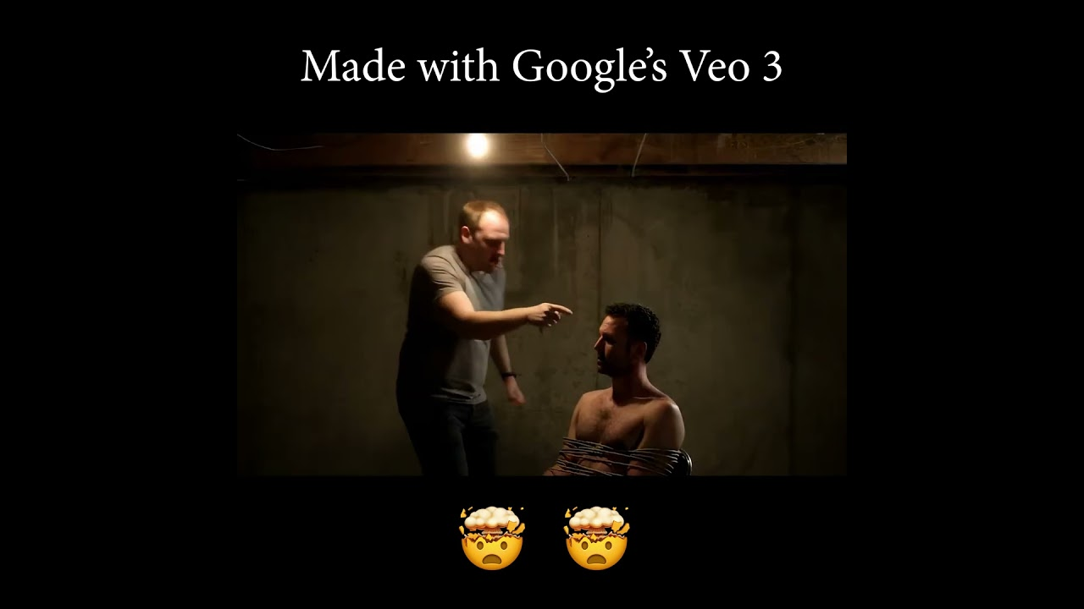
Video
May 23, 2025
Google launched a text-to-video generation model called Veo that went viral for surrealist existentialism

Slide 50

And ASMR videos of knives cutting frozen glass fruits (But first… we meme)

Slide 51
June 6, 2025 - SERIOUS NOTE RE “DISPOSABLE VIDEO” AND EASE
Andrej Karpathy, one of the leading minds in artificial intelligence, made the point that video is now so easy to create that people can start using gradient descent tricks to maximize engagement or other metrics. We might end up with even more addictive content than our current social media platform algorithms deliver.
Think of SEO… now think of personal videos to hit every single type of person…
Not just a video of how to make salsa…
Every ethnicity making salsa…
Every language making salsa…
Every location making salsa (beach in the window, farm in the window)
Every type of kitchen (wooden, steel, marble, travertine, modern, rustic)
AI video generation company Runway partnered with AMC networks for video production.

Slide 52

July 18, 2025
Runway launched a video motion capture feature that doesn’t need greenscreens and can map any motion to animate an image (nothing is real in this video)
python3 eml-to-text.py
python3 rundown.py

Slide 53

August 2, 2025
Runway launched Aleph, which is an incredible video editor. Hyper-realistic.

Slide 54
If we think oversaturated high dynamic range is a temptation for real estate videos…
https://x.com/runwayml/status/1951345545483579704
https://x.com/runwayml/status/1950903868499337578

Slide 55
Trend TWO: Multimodality
Interacting with AI using audio, imagery, or video instead of chatting

Slide 56
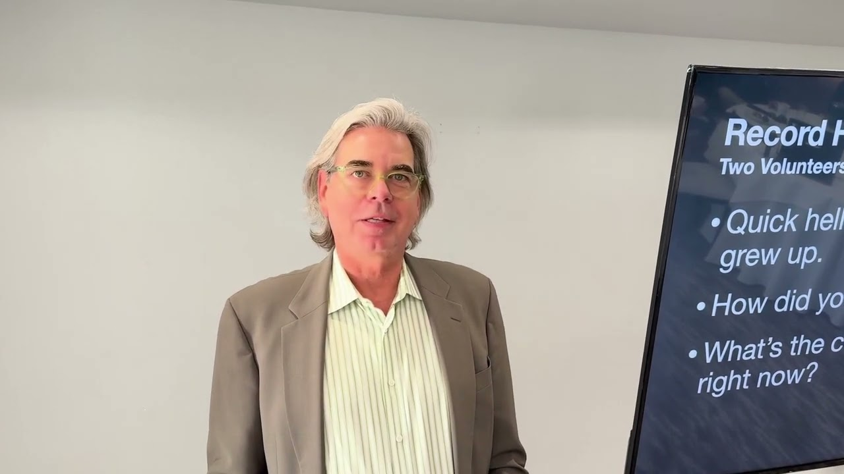
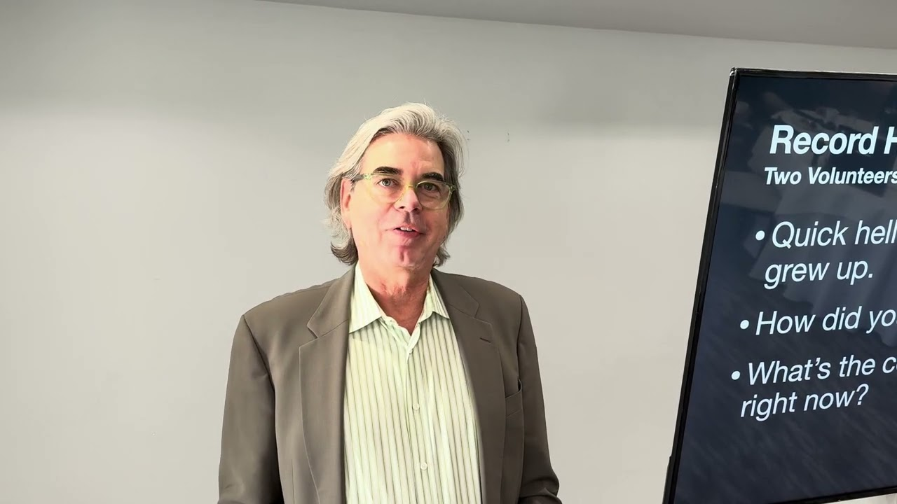
Remember, we did a fun HeyGen demo!
Two Volunteers - Male/Female - Switched their language

Slide 57
We chatted with voice mode…. Remember that?
https://openai.com/index/chatgpt-can-now-see-hear-and-speak/
Talked with me about my presentation
Helped me browse the web by seeing my screen
Looked around the room using my camera
Gave me a description of the room for a real estate listing
Redid it in Spanish. French. German.
I showed it a math problem and it explain it using a realty example

Slide 58
Yellow text time again…
A TON HAPPENED SINCE FEBRUARY IN MULTIMODAL NEWS, ESPECIALLY IN MEDICINE

Slide 59
Multimodality
March 7, 2025
Microsoft’s Phi-4 Multimodal Takes Top Spot in Speech Recognition (OpenSource)
Sesame Launches Voice AI That Rivals Human Interaction
March 21, 2025
OpenAI has released three advanced audio models, which include text-to-speech and speech-to-text with better transcription
March 28. 2025
Researchers developed an AI model that can identify endometrial cancer in tissue samples with a 99.2% accuracy rate. This is significantly better than the current best-in-class methods which are at 80%.
April 11, 2025
Google has integrated vision into its AI tools, finally catching up to OpenAI’s multimodal product.
Audio leader ElevenLabs has adopted Anthropic’s model context protocol (MCP) to enable locally running servers to create voice agents to make outbound calls and clone voices.

Slide 60

Let’s try it!
https://www.facebook.com/photo.php?fbid=702461572763982&set=pb.100090004377401.-2207520000&type=3
April 18, 2025
OpenAI o3 is getting rave reviews. In particular, it can combine every single ChatGPT tool, including web search, Python coding, visual analysis, and image generation. It’s exceptional with math and coding, and has a more natural conversational style.
Google has announced a model that is going to attempt to talk with dolphins.
Anthropic is coming out with a voice feature to compete with OpenAI.
Meta released two open-weight vision models.
AI can now find a location using only a single photo with no attached metadata.
Also, someone text me a picture of something outside to test.

Slide 61
April 25, 2025
Microsoft added the ability to “see” to its web browser. It’s also launched computer use and web browsing within the operating system.
May 9, 2025
OpenAI’s o3 analyzed a Harvard Business School case study PDF, extracted scattered financial data and built a business model comparable to an MBA student.
May 16, 2025
Amazon launched Nova Sonic, that can have natural back-and-forth conversations in real time. Sounds like Alexa wants to drink Siri’s milkshake.
June 6, 2025
The FDA approved the first AI tool to predict breast cancer risk from mammograms.
June 14, 2025
Meta released a robot training system that learns how the physical world works by watching videos, similar to children developing intuitions by watching the world.
Instagram is testing features that convert static photos into a 3-D images.
OpenAI updated their voice mode to be a lot more expressive. You can ask the voice to sound nervous, excited, or jittery, and the new voice features can capture those emotions.

Slide 62
June 20, 2025
OpenAI rolled out a record mode for ChatGPT and can capture meetings and voice notes.
June 27, 2025
Amazon Ring launched video descriptions where your security camera simply tells you what’s happening outside so you don’t need to look at the camera. It could email you what happened or describe it out loud as it happens. “A guy drove up in a UPS truck and put a box on your front steps.” “A woman is at the door with a dog on a leash and keeps looking into the window.” Etc.
A few months ago, Google DeepMind released a tool called VideoPrism that is suddenly gaining attention. VideoPrism can watch a video and provide deep context and details about every frame, a task that would be virtually impossible for a human to accomplish. Think real estate, legal discovery, etc…
https://research.google/blog/videoprism-a-foundational-visual-encoder-for-video-understanding/ <- Quick look at it in action

Slide 63
June 27, 2025 (continued)
Alibaba developed a system that can identify gastric cancer from standard CT scans with greater accuracy than doctors. China has already deployed the system and screened over 78,000 patients!
Google also launched an update of their Gemma model which is designed to run locally on smart phones and edge devices. Gemma provides multimodal AI capabilities without any Internet connection. In addition to being able to understand text, images, audio, and video, the model can handle translation and is open source.
Google DeepMind released an AI system called AlphaGenome that predicts how genetic variations affect biological processes and can analyze DNA sequences up to 1 million letters long.
July 4, 2025
Researchers have developed an artificial intelligence system that can detect Parkinson’s disease by analyzing short videos of people smiling, achieving 88% accuracy.
Mayo Clinic researchers have created an artificial intelligence tool that can identify nine different types of dementia from a single brain scan.

Slide 64
July 4, 2025
Microsoft researchers developed an AI diagnostic system that correctly solved 85% of complex medical cases from the New England Journal of Medicine compared to just 20% accuracy achieved by experienced physicians.
The Olympics are implementing artificial intelligence across quite a few areas of the coming winter Olympics.
Broadcast partners during the last Olympic games used AI to transform 11,000 hours of footage into 97,000 highlight clips.
Alibaba and Omega are using depth and segmentation (two great terms to know!) to track athlete movements and give biomechanical analysis.
ElevenLabs released a new tool that creates custom synthetic voices that are extremely dynamic and might be putting the voiceover professional out of work. These are worth checking out as they are very dynamic and have the ability to be guided to match the timbre and enthusiasm of the script.
Andrej Karpathy a great point that local models are making significant inroads and will soon be the bridge between devices in the cloud, small models can process text, images, and audio offline, and then hook into external tools as needed.

Slide 65
July 4, 2025 (continued)
Nvidia released an 8 billion parameter vision model designed for document processing and character recognition. This can extract and understand information from complex documents, PDFs, images, tables, charts, formulas, and diagrams. This will lead to automating workflows in finance healthcare and law firms. These models will also help with invoice processing and compliance.
Google released a hurricane forecasting model for with long-term forecasting… up to two weeks ahead of a storm.
July 18, 2025
ChatGPT is on track to edit and understand Excel and PowerPoint within chats, without opening Microsoft Office.
July 25, 2025
Meta released a dataset of 4,000+ videos of face-to-face conversations and over 65,000 social interactions with full annotations to help models learn and emulate behavior.
Google DeepMind released an AI tool called Aeneas that will help historians interpret fragments of Latin inscriptions.
August 8, 2025
Google released a world simulation model that creates entire explorable 3D worlds with just a prompt.

Slide 66
Bam. We’re crushing it.

Slide 67
Trend THREE: Agency
AI taking actions on your behalf
Language is an interface

Slide 68
In February, We Ran A Perplexity Deep Research Demo
“I'd like to get a recommendation on a home to purchase in Sussex County Delaware for $750,000 or less. I'd like to try to identify the best value for that price that I could hold onto and resell and I'd like to find the strongest realtor in the area to represent me as a buyer.”
https://www.perplexity.ai/
Results: https://www.perplexity.ai/search/i-d-like-to-get-a-recommendati-TQBjHA63Qc.fehbgIGf4hA
Since February EVERY model now has a research agent… if you’re not using deep research you are missing opportunities in any subject!
I use it dozens of times per day for my entire family. Incessantly.

Slide 69
Simple.ai <-LINK
In February we did a demo call with Kathleen
The audience wrote five things we wanted to find out from Kathleen on index cards
The AI called Kathleen, got the answers, and then sent me an email summary of their conversation.
You’ll see a lot of this in our review in a moment.

Slide 70
Consumers are using agents to reach out to companies.
Companies are building agents to answer consumers.

Slide 71
Yellow text time again…
A TON HAPPENED SINCE FEBRUARY WITH AGENTS.

Slide 72

IronLedger (YCombinator) provides AI agents for property accounting, starting with accounts payable.
They're “already eliminating 100s of hours of work for 1000s of multifamily units every month.” -July 30, 205

Slide 73
Agents
March 7, 2025
OpenAI Plans Premium AI “Agents” with Monthly Fees Up to $20,000
Amazon Developing AI Reasoning Model Under Nova Brand
AI financial analyst Endex emerges from stealth with OpenAI partnership
Adam Silverman Predicts UI Design Will Shift From Human to Agent Experience
March 14, 2025
OpenAI is pushing the pace of agent adoption (AIs that can take action on your behalf) with the addition of commands that can help developers build agents that can search the web, look through local files, and even control your computer.
Legal AI provider, Harvey, has built agents that are outperforming humans at law firms.
https://x.com/harvey/status/1899491666429632907 <-Watch this later!
Another breakthrough product comes out of China called Manus, with building hype coming off of the previous week’s announcement. This is a product that is built on top of Anthropic’s Claude that has 29 additional agent tools, like browser control. https://manus.im/
The Pentagon signed a deal to use AI agents for military planning.

Slide 74
March 21 2025
Nvidia released two open models that allow AI agents to reason.
Anthropic has given its AI the ability to search the web
A new study came out that shows that AI agents are doubling their abilities every seven months.
March 28, 2025
A few months ago, Anthropic released a structured method of allowing AI models to talk to third-party systems. This is called the “Model Context Protocol” or MCP for short. This week OpenAI announced that it would adopt Anthropic’s standard.
Researchers at Harvard conducted a randomized trial with 776 Procter & Gamble employees and found that a single person can work as well as a two-person team if given AI tools. - THIS MEANS YOU, REALTORS
A trend in the last two weeks is developers releasing text files with detailed language model instructions in text.
Lockheed Martin and Google announced an integration of Google’s AI tools into Lockheed’s factory systems.

Slide 75
April 4, 2025
Amazon released an amazing new model that can perform tasks using web browsers. It has over 90% accuracy.
Automation tool Zapier has now integrated over 8000 apps with the model context protocol. It may take a few more months for this to trickle down to lay people, but I think automation of tasks is going to be a welcome discovery once it becomes demystified.
April 11, 2025
Google launched their own open agent protocol that allows agents from different vendors to communicate. At the same time, Google announced they will adopt and support Anthropic’s model context protocol (MCP) agent structure.
Google released a Deep Research competitor to OpenAI and Perplexity. Thanks to Google’s deep integration with search, Google’s Deep Research is already outperforming PhD-level researchers when given access to the web.
Adobe plans to integrate AI agents throughout its Creative Cloud product lineup to automate the mundane parts of creative operations as well as improve context-aware search within videos and photos.

Slide 76
April 25, 2025
Anthropic predicts fully automated AI employees within the next 12 months.
Along those lines, Microsoft predicts that 2025 will be the year that “frontier firms” emerge and AI employees begin to lead operational tasks.
Anthropic launched a research feature. This means that Google, OpenAI, Perplexity, Claude, and DeepSeek all now have robust research capabilities. This is also a harbinger for the end of the Internet as we know it.
ElevenLabs, the audio AI company, has developed a method to allow voice agents to transfer calls to other voice agents. That’s a spectacular development and it implies that different specialists agents could take on different tasks and transfer those tasks, just like humans do now. I would say call centers are soon to be an extinct species.
A new benchmark has shown that OpenAI’s O3 model can outperform 94 percent of expert virologists.
May 02, 2025
Yelp began testing AI-powered voice agents to help restaurants and businesses manage incoming phone calls.

Slide 77
May 9, 2025
Google Gemini’s 2.5 Pro model became the first model to achieve the number one rank across all text, vision, and web dev benchmarks simultaneously. The model can watch videos and convert them into functional web applications. Gemini has such a large memory that it can review 50,000 lines of code (!) at once within a chat window with no problem.
Former Google CEO Eric Schmitt has a startup called FutureHouse which has built five specialized artificial intelligence agents to help scientists navigate large amounts of data and research.
May 16, 2025
Google released AlphaEvolve, a strong reasoning agent that found the best human solution to 70% of the toughest known logic problems. It actually went beyond humans, and for 20% of the problems (!), it found a novel solution that no one had thought of before and improved on the best known solution. Google is using this model to self improve its workflow and has been able to achieve 23% efficiency boosts internally.
OpenAI’s latest models are exceeding human doctors across standard medical knowledge tests. Six months ago, “AI plus humans” were the best at the test but now “AI without humans” is the best.

Slide 78
May 23, 2025
Microsoft launched a science agent which discovered a new material in a few hours. Not only was the new material discovered, but scientists were able to synthesize the compound in the laboratory.
May 30, 2025
OpenAI went on the record that they plan to launch a super assistant in the first half of 2025.
Doctors at Harvard and Stanford benchmarked OpenAI’s o1 preview model and reconfirmed it displayed superhuman diagnostics and reasoning in medicine.
June 20, 2025
Microsoft released an upgrade to its assistant that can see and analyze what’s on your computer screen to give real-time guidance or directions to troubleshoot or modify settings and use software.
The UK deployed a system called Extract that converts complex planning documents, including handwritten notes and blurry maps, into digital data within 40 seconds.
Japan’s largest bank partnered with AI company Sakana to automate banking document creation.

Slide 79
June 20, 2025 (continued)
Russia’s Sberbank announced plans to create their own AI system with advanced reasoning capabilities.
Salesforce released a marketing suite of tools that can handle routine marketing tasks like building audience segments, writing email copy, and managing ad performance. These agents can work independently or assist marketing managers, and take directions like building a campaign or creating personalized offers.
A model specifically trained for medical use can answer questions as well as human physicians on healthcare benchmarks. What’s really wild about this model is that it is 70% smaller than most models and can run on a laptop locally. We’re getting to the point where everyone will be able to have a physician in their pocket without even being connected to the cloud.

Slide 80
June 27, 2025
Legal AI software company Harvey released a demonstration of their latest workflow tool, which essentially chopped the bottom out of legal work and would terrify me if I were a student in law school.
OpenAI added both document editing and chat to ChatGPT, which directly competes against Microsoft Office and Google Docs
Microsoft announced a very small model that can run locally on a PC to help users change system settings, using natural language… basically like Alexa for your laptop settings.
July 4, 2025
A legal AI assistant company called Legora made the radar this week with an introduction of a product called workflows (the same exact name as the product from competing firm Harvey). This allows the automation of due diligence document analysis and legal research using natural language commands. It seems like a harbinger of the end of the paralegal era.
Writing assistant company Grammarly is acquiring email automation provider Superhuman to combine writing assistance with email management for automating transactional communication. (real estate, law, accounting, sales)

Slide 81
July 11, 2025
A new tool trained to work on Excel spreadsheets is able to achieve a score of 80% on the Excel World Championship test in only 10 minutes. That is 10 times faster than a human.
July 18, 2025
Anthropic launched an enterprise solution for major financial data providers. Norway’s sovereign wealth fund beta tested it and reported a 20% efficiency boost, equivalent to 213,000 saved hours. AIG sped up their underwriting time by 5x and improved data accuracy from 75% to 90%.
OpenAI launched an agent designed for investment banking. It’s specifically made to analyze financial documents and create pitch decks and can also help with valuations and due diligence. Beta testers reported up to 70% reductions in document prep time.
Andrej Karpathy mused that if AI becomes the main consumer of data and research papers, the format and language might become compressed or shifted to accommodate the efficiency of an LLM as a reader. - WHAT DOES THIS MEAN FOR REAL ESTATE SEARCH IF THE USERS ARE AI BOTS AND NOT PEOPLE?

Slide 82
July 25, 2025
Multiple models threw their hat into the ring of the recent International Mathematics Olympiad, a world class high school math competition.
Google Gemini and OpenAI both achieved gold medals in the math competition.
August 8, 2025
Google launched Gemini DeepThink which is a consumer version of the thinking engine used to win the International Math Olympiad recently.
Singapore start-up Manus announced Wide Research which empowers multiple agents across multiple models (as a wrapper). It’s supposedly incredibly powerful for dauntingly scaled tasks like researching all Fortune 100 companies at the same time.
Andreessen Horowitz is backing voice agent platform, EliseAI, which makes AI voice agents for property management, and healthcare, at a $2B valuation!
ElevenLabs announced their redesigned interface for AI voice conversation agents.
Shopify continues to roll out conversational commerce agents.

Slide 83
In February we asked “What Is Going to Happen?”
“The ‘content’ of any medium is always another medium. The content of writing is speech, just as the written word is the content of print, and print is the content of the telegraph.” – Marshall McLuhan 1964

Slide 84
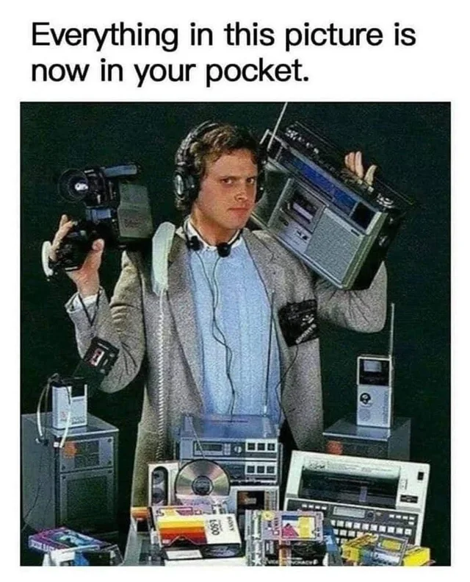
Each new medium both contains and can emulate the mediums it replaces. The internet contains and emulates film, radio, television, publishing, and retail.
The content of AI will include… the Internet.

Slide 85
In February we asked:
What will happen to apps? Keyboards? Browsers? Seach engines?
….Property listings?

Slide 86
Let’s see what’s happened to web use and SEO in the six months since we last met…

Slide 87
Last time for yellow text!
It’s worth it.
The internet is changing quickly.

Slide 88
Browsers, SEO and Publishing
February 28, 2025
New Alexa powered by Claude
Perplexity planning AI browser (Comet)
March 7, 2025
Apple may be preparing Gemini integration in Apple Intelligence
Perplexity Launches Enterprise File Integration
March 21, 2025
Payment processing provider Stripe has created a template to allow companies to share transaction documentation with AI agents. Never leave the chat!
April 18, 2025
It’s rumored that OpenAI is creating a social media platform
A company called Firecrawl has released a web scraper that can navigate complex websites and fill out forms.

Slide 89
April 25, 2025
Google announced that its AI-enhanced search now reaches 1.5 billion users per month.
A study showed that these AI overviews reduce click-through rates by 34%.
Andrej Karpathy, one of the most generous, smartest, kindest, and broad-visioned voices in AI (and I don’t say that lightly), co-founder of OpenAI and former head of AI at Tesla, has said that our primary audience as product developers, publishers, and e-commerce website developers is no longer human. Instead, our primary audience is going to be web crawlers and agents that are looking on behalf of people who have asked them questions. WHAT IS A LISTING THEN?
OpenAI has expressed interest in purchasing the Google Chrome browser, if given the chance.
The Washington Post has partnered with OpenAI to include news within ChatGPT chats.
Adobe has now incorporated Google and OpenAI’s models into its Firefly product.
May 02, 2025
OpenAI rolled out enhanced ChatGPT shopping.
Mastercard and Visa also separately introduced AI agent integration into their payment systems to automate AI purchasing.

Slide 90
May 9, 2025
Both OpenAI and Google have integrated shopping capabilities into their AI features. Big change is coming for retailers (and affiliate models) this year.
Anthropic has integrated web searching into both its chat model and the API. This is yet another shift in the publishing landscape and the internet itself, as models search the Internet and retrieve information without leaving the chat.
Apple plans to add artificial intelligence search options to its web browser, Safari.
LinkedIn added AI powered job searching which supposedly allows users to search for jobs using plain language descriptions. Zillow did this over a year ago with plain language home searches.

Slide 91
May 23, 2025
If agents weren’t enough, interfaces are officially beginning to be disrupted. OpenAI acquired Apple designer Jony Ive’s company for $6.5 billion. The rumor is they are going to build a device that has no graphical user interface.
Google has launched an Internet agent that can manage up to 10 web-based tasks at the same time, including things like booking flights or making restaurant reservations. Even with a web interface like a browser, if the system takes a search query and goes out throughout the entire Internet to accommodate requests, that implies it might as well be a non-graphical interface. You just ask Google what you want and Chrome goes and does it.
Google’s Internet agent can save tasks to repeat on a regular basis. For example, if you want to check real estate listings, instead of opening the apps, Google will check them every day for you and even schedule viewings of properties.
https://x.com/Google/status/1924877428997939563 <- In MAY.
AI search tool Perplexity reports that people are booking hotels directly through its AI search platform more and more every day. Hotel advertising is Google’s second-largest category.

Slide 92
May 30, 2025
A startup called the Browser Company announced that they were building a web browser that was chat interface-based as opposed to page-based. The press release bluntly said that web browsers will die.
The CEO of Perplexity predicts that AI agents will decimate Google search volume and shift traditional cost per click budgets to AI integration.
Perplexity released a new feature called Labs, which is a powerful search mode that handles complex projects like building dashboards or mini applications. Labs supports interactive tool use beyond basic web searching. For example, creating financial reports from more than one source, aggregating findings, and creating charts and visualizations.
Microsoft announced a commitment to “The Agentic Web,” where AI programs team up and collaborate to go out on the Internet on our behalf so we no longer have to browse. - - - THIS IS HAPPENING.

Slide 93
June 06, 2025
Meta plans to fully automate their advertising tools by 2026 using artificial intelligence. Completely cutting out the creative process and middle persons.
Opera released a browser called Neon that uses AI agents to automatically complete tasks like filling out forms or booking trips while users browse the web.
H Company introduced web automation agents that are able to read, click, and type on websites with 92% accuracy.
Firecrawl launched a hosted service that connects web scraping abilities directly to the large frontier models. (Savvy people will create tools to compete with you)
June 14, 2025
Google started to roll out data visualization features in their AI search results that automatically create interactive graphs for stock and mutual fund queries. These visualizations are built on the fly using Gemini’s reasoning capabilities to build whatever charts or graphs “Google thinks” best fits the data question. This is bigger than it might initially seem as user interfaces will suddenly just appear in front of us rather than being built in advance.
Perplexity has launched an AI browser called Comet that appears to be gaining loyalty among power users. It integrates with browser history and can read emails and attempts to think ahead of people’s intentions… you just confirm as you go.

Slide 94
July 18, 2025
OpenAI launched “Agent” which combines web browsing, deep research, coding, and file manipulation. I’ve been using it for two weeks (I’m behind on my newsletter, so this is being written post-launch). It’s wild to watch Agent open a small window inside the chat, where it opens websites and navigates my emails, logs into LinkedIn, and creates spreadsheets and Google docs.
Google is adding AI features into search and Chrome. There’s now an option to have AI call a business on your behalf (we predicted via Simple.ai this spring). That was faster than I expected.
August 2, 2025
Google’s AI overviews reached 2 billion monthly users (up from 1.5 in April)

Slide 95
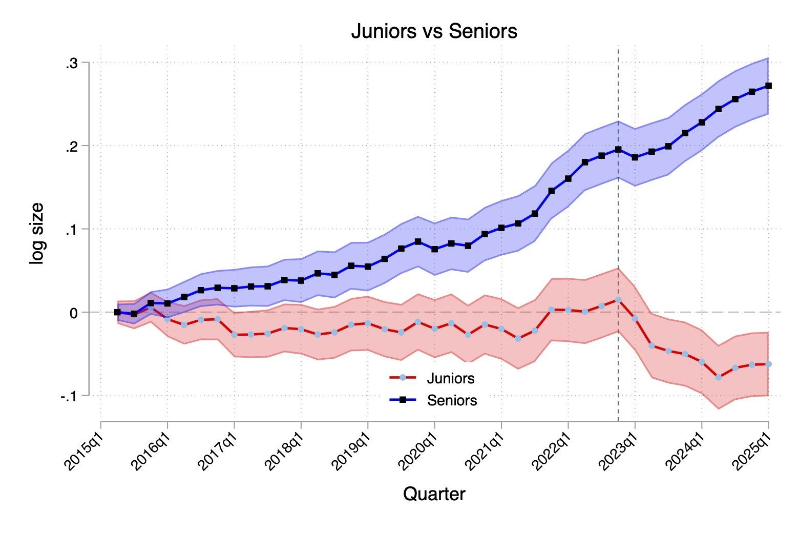
“A second paper in a week also finds Generative AI is reducing the number of junior people hired (while not impacting senior roles).
This one compares firms across industries who have hired for at least one AI project versus those that have not. Firms using AI were hiring fewer juniors.” - Ethan Mollick Sept 2, 2025
I have several pages of job impact and layoff bullets and will share them digitally.

Slide 96
I asked GPT Pro ($200/month) what you should know. Here’s what it said:
If your value is “forward MLS links and open doors,” you’re replaceable. If your value is “win the house / avoid the landmine,” you’ll thrive.
Will SEO disappear?
No—but classic SEO shrinks where answer engines/portal chats satisfy the query. Your Sussex strategy is AEO (answer engine optimization): publish citable, structured, local answers (tax math, STR rules, micro‑market stats, flood resources) and capture the next action (chat, showing, consult)
What about AI agents doing the job better?
They’ll do the busywork faster—and they’ll quote whoever has the best local receipts. Make sure that’s you (Monument Sotheby’s Coastal Division): your concierge, your data hub, your on‑the‑ground judgment.
“Is real estate at risk of automation?”
Yes—tasks, not the whole job. A realistic 3‑year automation scorecard (what AI will handle well vs. where humans win):
High automation (70–90%): first‑response lead handling; search/match by plain English; tour routing; document prep/checklists; marketing copy drafts; status updates; basic CMAs. (This is exactly where portals’ AIs are moving.) Zillow GroupRedfin
Medium (30–60%): valuation nuance (unique lots, condition risk), offer strategy under competitive dynamics, inspection/repair negotiation, reading the room at the table.
Low (≤30%): fiduciary trust, complex negotiations, local risk judgment (well/septic, flood/insurance), reputation leverage, and accountability when things go sideways.

Slide 97
You are officially AI experts.
If we have time, let’s do some QA
(Link to presentation is on next slide)

Slide 98

Link To The First Presentation
(I’ll add these slides and more there too)

