Slide 1
AI Virtual Inn of Court: Kick-off
Ethan Holland
September 16, 2025

Slide 2
This deck is a take home resource with everything you need to know.
It’s a labor of love from me to the Inns, and I’m happy to chat with you any time.

Slide 3
Our goal today is a fun, educational, and inspiring opening to set the tone for a great year.
I’ll present for 20 minutes and then we’ll open to discussion. I’ll pause for questions and feel free to interrupt me along the way.

Slide 4
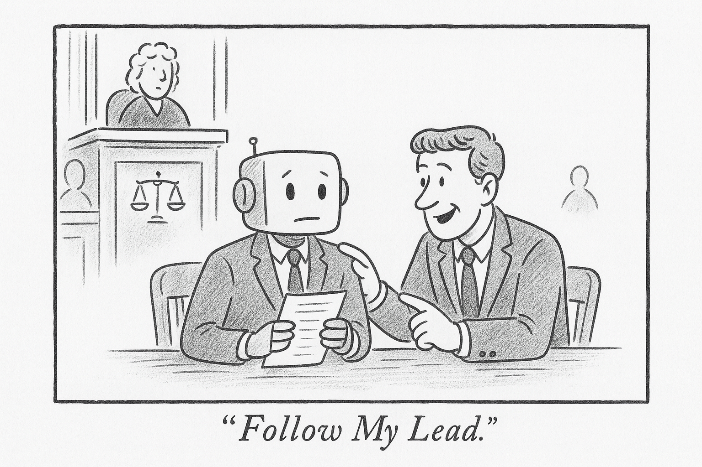
Agenda
About me
Guiding principles
Terms
  Generative AI
  Multimodal AI
  Agents
  Open Source
“Three minutes of awe!”
Open discussion and Q&A

Slide 5
About Me

Slide 6
30 Years Transforming Legacy
Companies -> Digital

Slide 7
Burpee Seed Catalog
Print -> eCommerce

Slide 8
Jewelry Television
Home Shopping -> eCommerce

Slide 9
American Eagle Outfitters
Mall Retail -> eCommerce

Slide 10
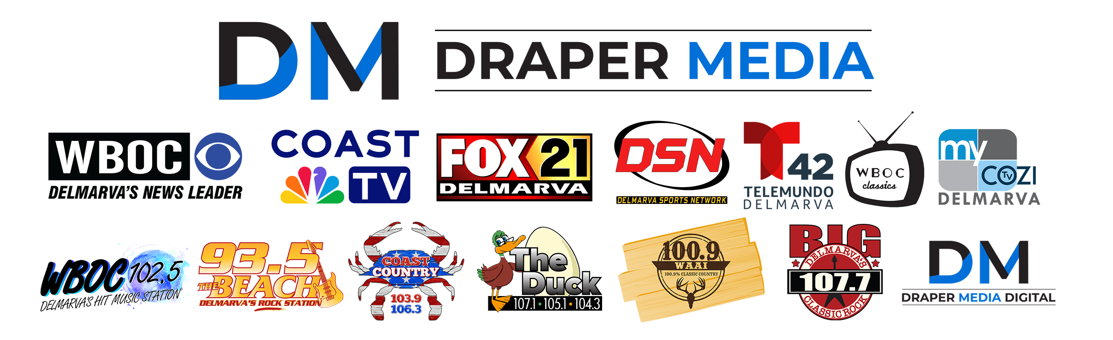
Currently VP Digital At Draper Media
VP Draper Digital Media

Slide 11
English Literature Major
No Computer Science Courses

Slide 12
Fun Adventures Along The Way
In My Career

Slide 13
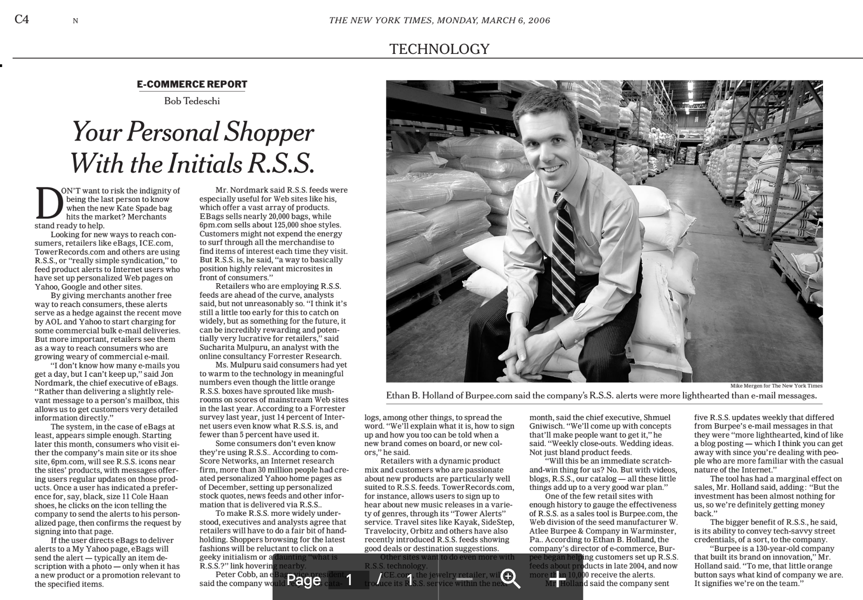

Slide 14
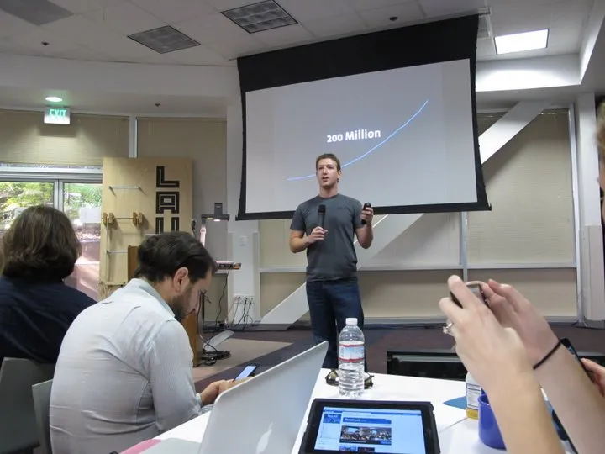
Product launches with Mark Zuckerberg

Slide 15

Keynote speaker at Adobe’s worldwide sales conference

Slide 16
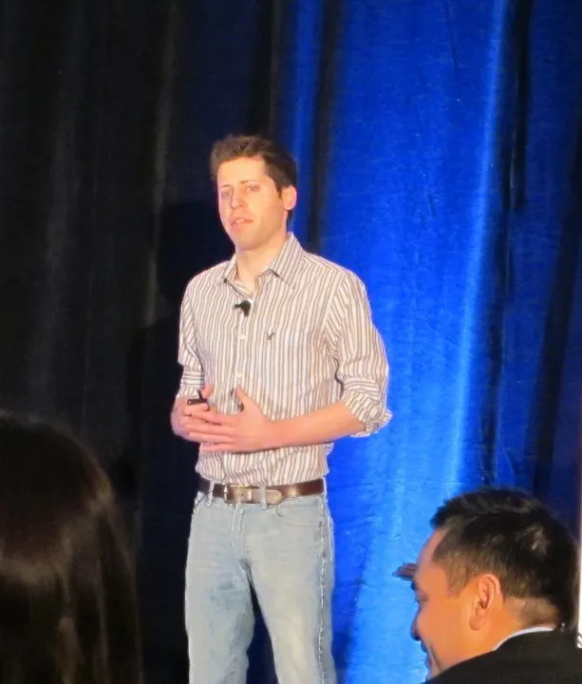
Presented with Sam Altman (long before OpenAI)

Slide 17
In October 2023, I launched a weekly AI news blog, organizing links by hand.

Slide 18
I made a decision to be the most informed person in the room when it came to AI.
Even if it meant “getting weird”

Slide 19
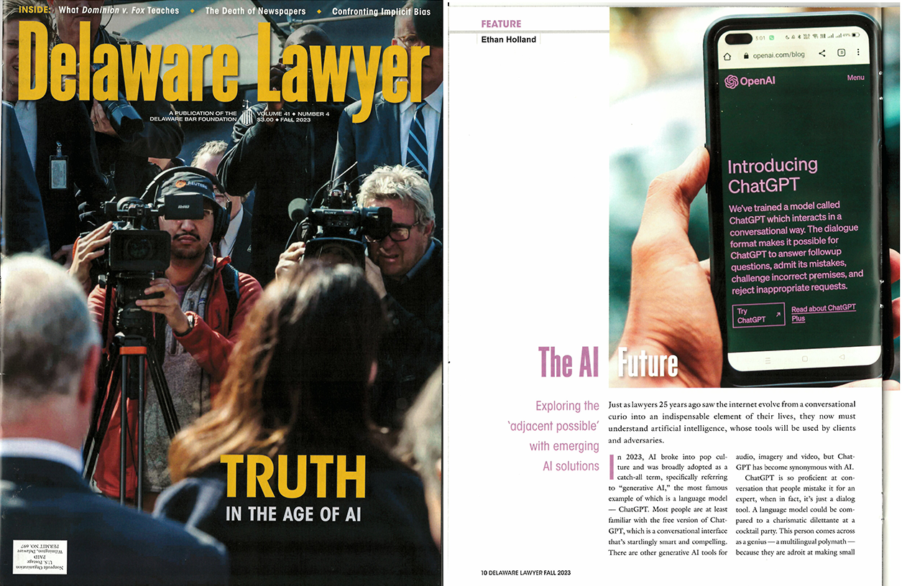
Fall 2023
Guest author in Delaware Lawyer
“The AI Future: Exploring the Adjacent Possible with Emerging AI Solutions”
Still recommend it as an introduction.
https://ethanbholland.com/2024/01/15/the-ai-future-exploring-the-adjacent-possible-with-emerging-ai-solutions/

Slide 20
Every week I manually review, organize and publish 500-700 AI headlines into 46 categories.

Slide 21
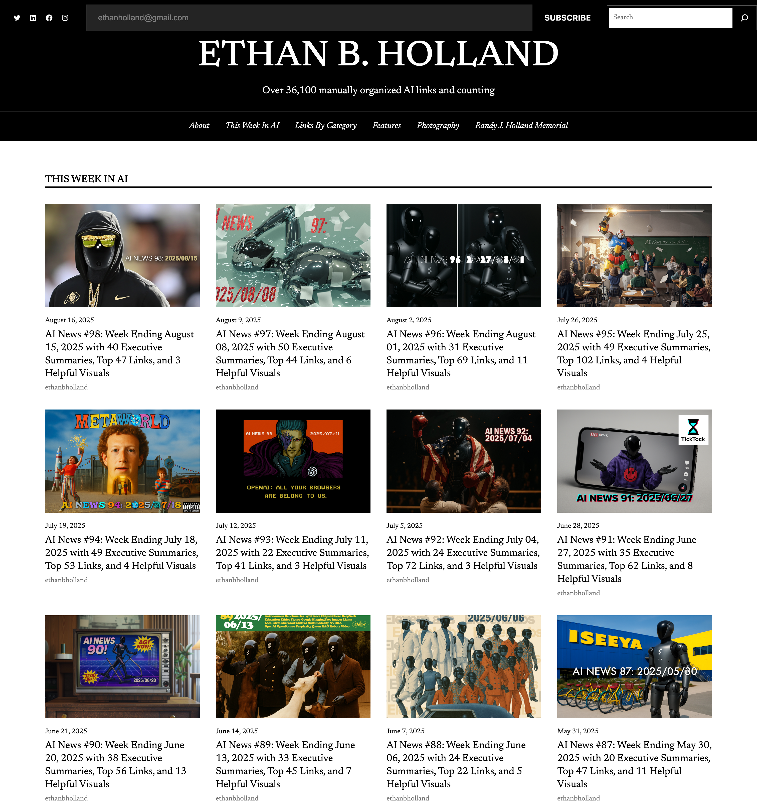
98 weeks later = 36,100 links.

Slide 22
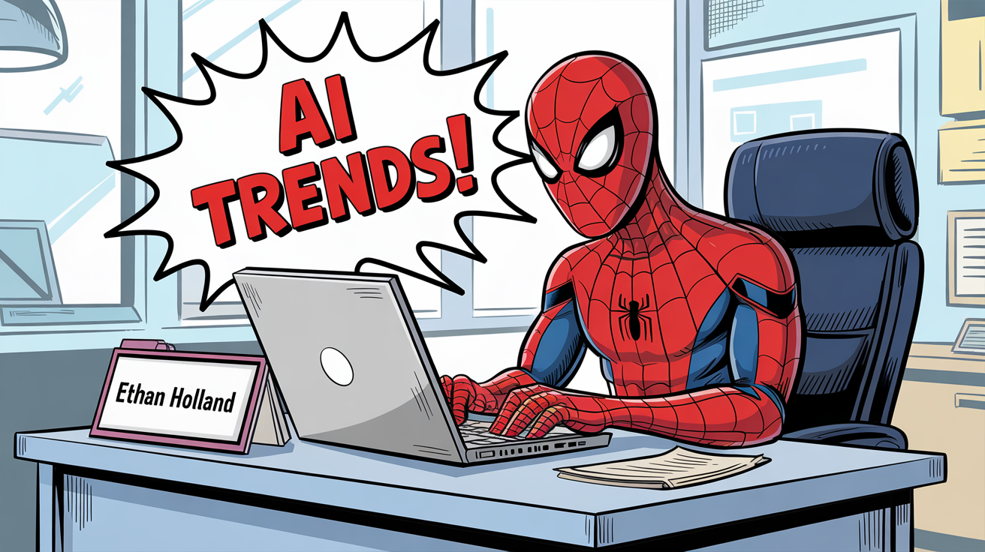


Reading 36,000 links has given me a “Spidey Sense” of where things are going.

Slide 23
Any time we discuss AI, I recommend three guiding principles:

Slide 24
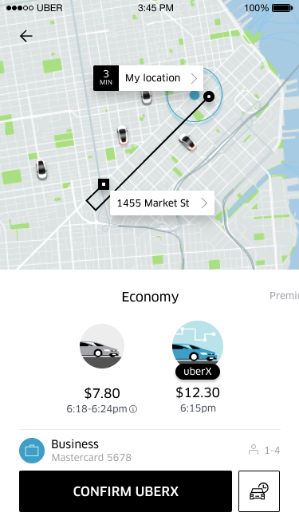
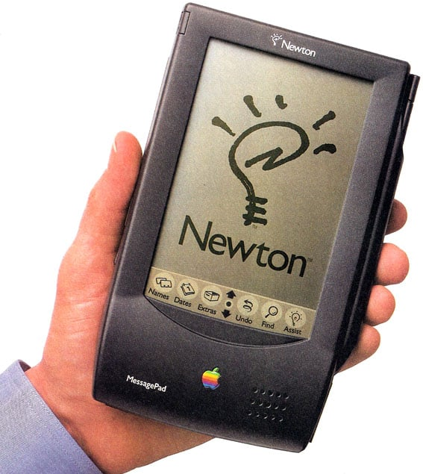

1) THE SUM is greater than the parts.
Think about how things we see today will connect in the future.
2008: iPhone 3G adds GPS to apps
2025: Uber = $200 billion market cap

Slide 25
2) When discussing AI align your timetable with your audience:
Short term
Mid term
Long term
Otherwise, it’s not the same conversation at all.

Slide 26
3) If possible, use the tool name or technology, not simply “AI”
GPT-5, Harvey, Gemini, Opus 4.1, Everlaw, Grok 4, Llama, CoCounsel, Mistral, ElevenLabs, Lexis, HeyGen, Flux, MidJourney, Mistral, Qwen, Deepseek, Runway, Kling, Viggle, NeRFs, LivePortrait, Gaussian Splats, Diffusion,…

Slide 27
Key AI Terms We’ll Discuss/Learn
Generative AI
Multimodal AI
Agents
Open Source

Slide 28
Common question:
I hear the term “AI” being used a lot and I get confused. What is AI and how does it differ from Generative AI? Is that difference important and if so, why?

Slide 29
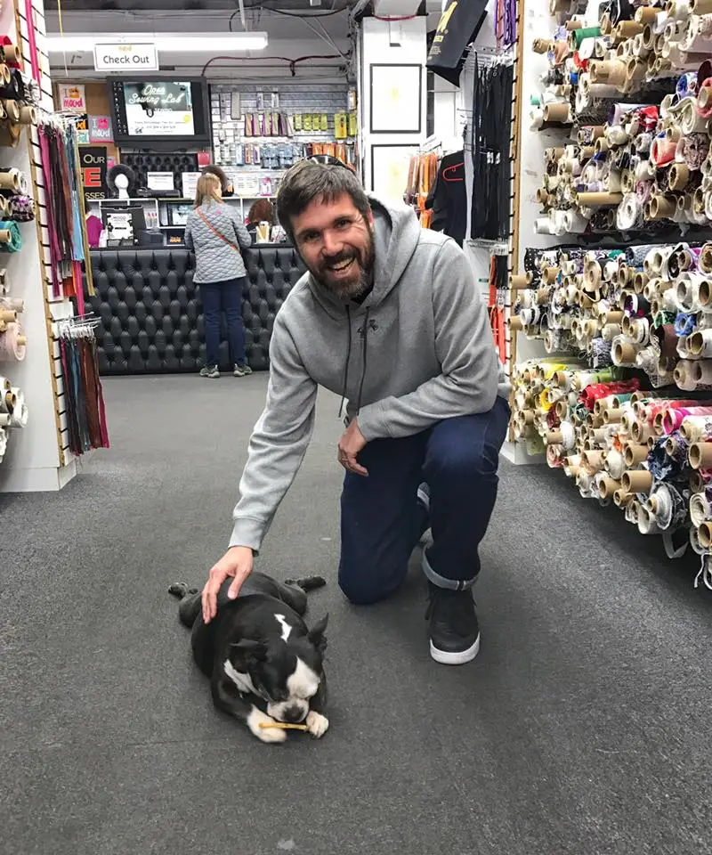



Term One: Basic Generative AI
Traditional Chat (most familiar)
ALSO Image generation
ALSO Video creation
“Grounded diffusion”

Slide 30
Term TWO: Multimodality
Interacting with AI using audio, imagery, or video instead of chatting

Slide 31
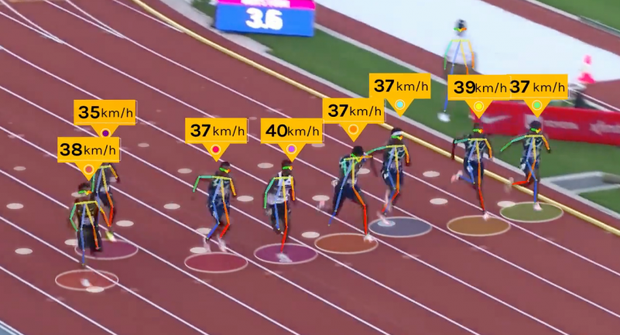
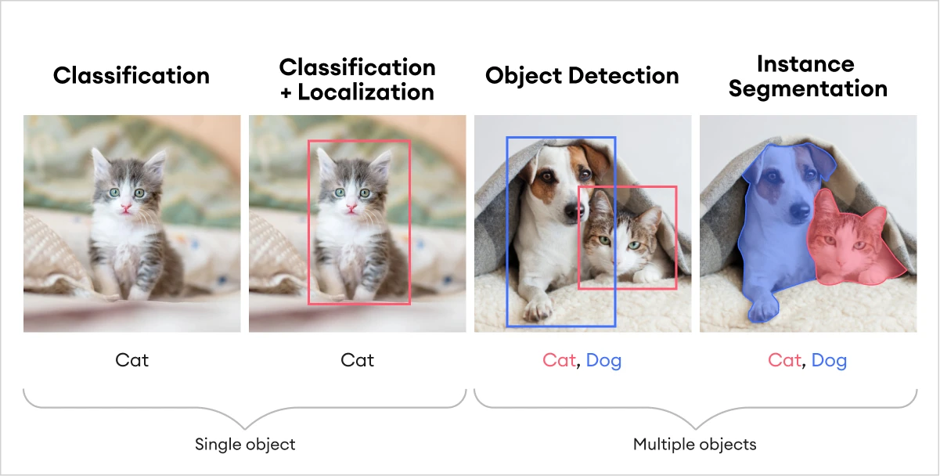
Multimodal AI is most familiar for it’s ability to:
Track objects athletes, vehicles, targets
Analyze medical imagery
Dub voices for audio translation
Create video clones
Index the contents of images, videos, or documents

Slide 32



Truly multimodal AI actually understands the sound waves of my voice as audio and does not need convert them into text. That’s what most people don’t realize…just as you hear and understand sound, AI understands sound.

Slide 33
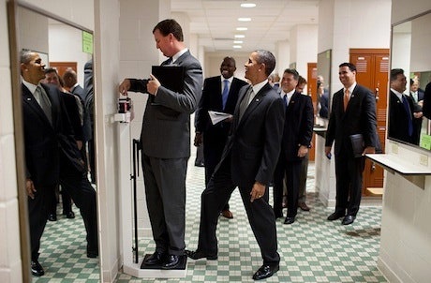
  Actual interaction with Google DeepMind’s multimodal model “Flamingo
  APRIL 2022 (3.5 YEARS AGO)
  How many people are in this photo
    “There at least five people in this photo”
  How many mirrors are in this photo?
    “There are at least two mirrors”
  What is the person on the scale doing?
    “He is looking at the scale”
  Where is Obama’s foot positioned?
    “Obama’s foot is on the right side of the scale”
  What happens as a result?
    “The scale shows a higher weight”
  Is the person on the scale aware of it?
    “He is not aware of it.”
Context Understanding

Slide 34
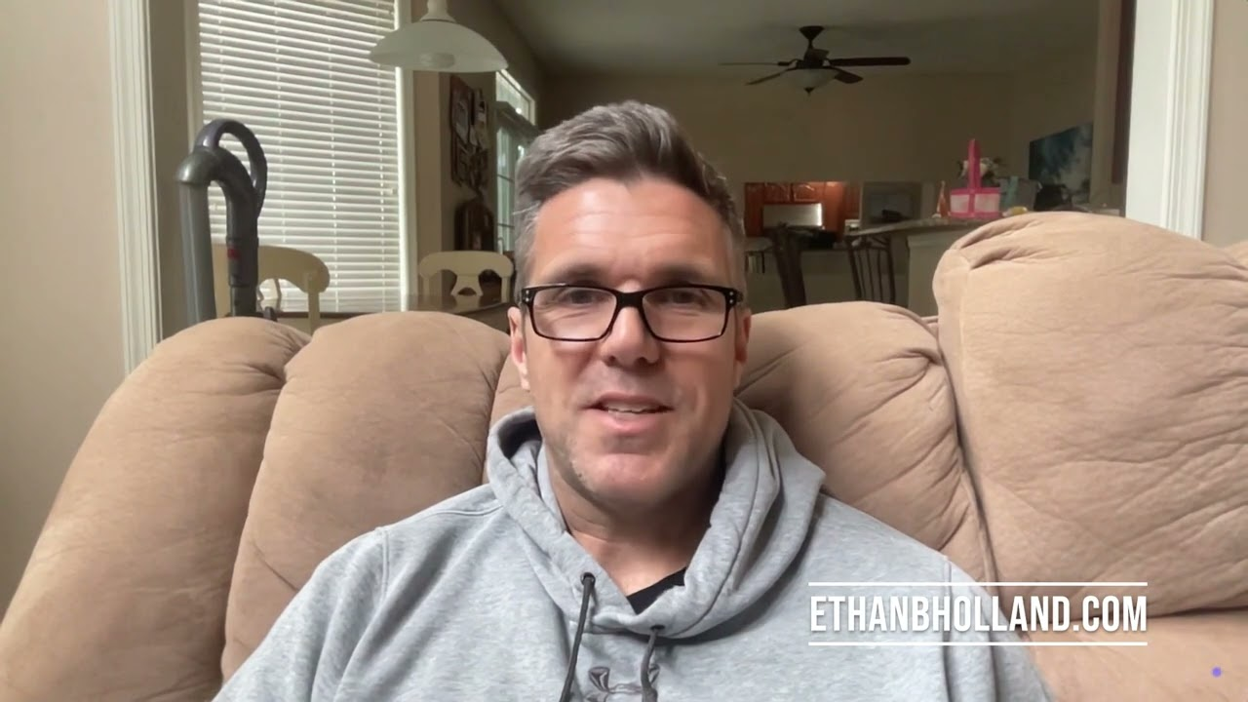
Multimodality might be new to laypeople, but here is an example of me from 2023… (90 second demo)

Slide 35
In 1995, I had a summer job as a paralegal and listened to audio of 100s of Meineke franchisee meetings.
Multimodal AI could have done an entire summer’s work in a few hours.

Slide 36
Common question:
What is “Agentic AI” and how will that change what we are doing currently?

Slide 37
Term THREE: Agency
AI taking actions on your behalf
Language is an interface

Slide 38
Like multimodality, agency helps us break away from thinking of AI as simply “chat bots”…

Slide 39
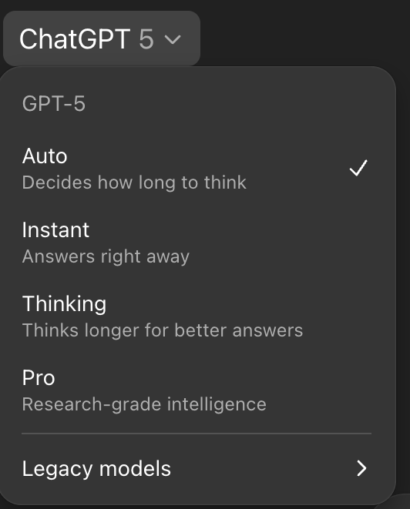
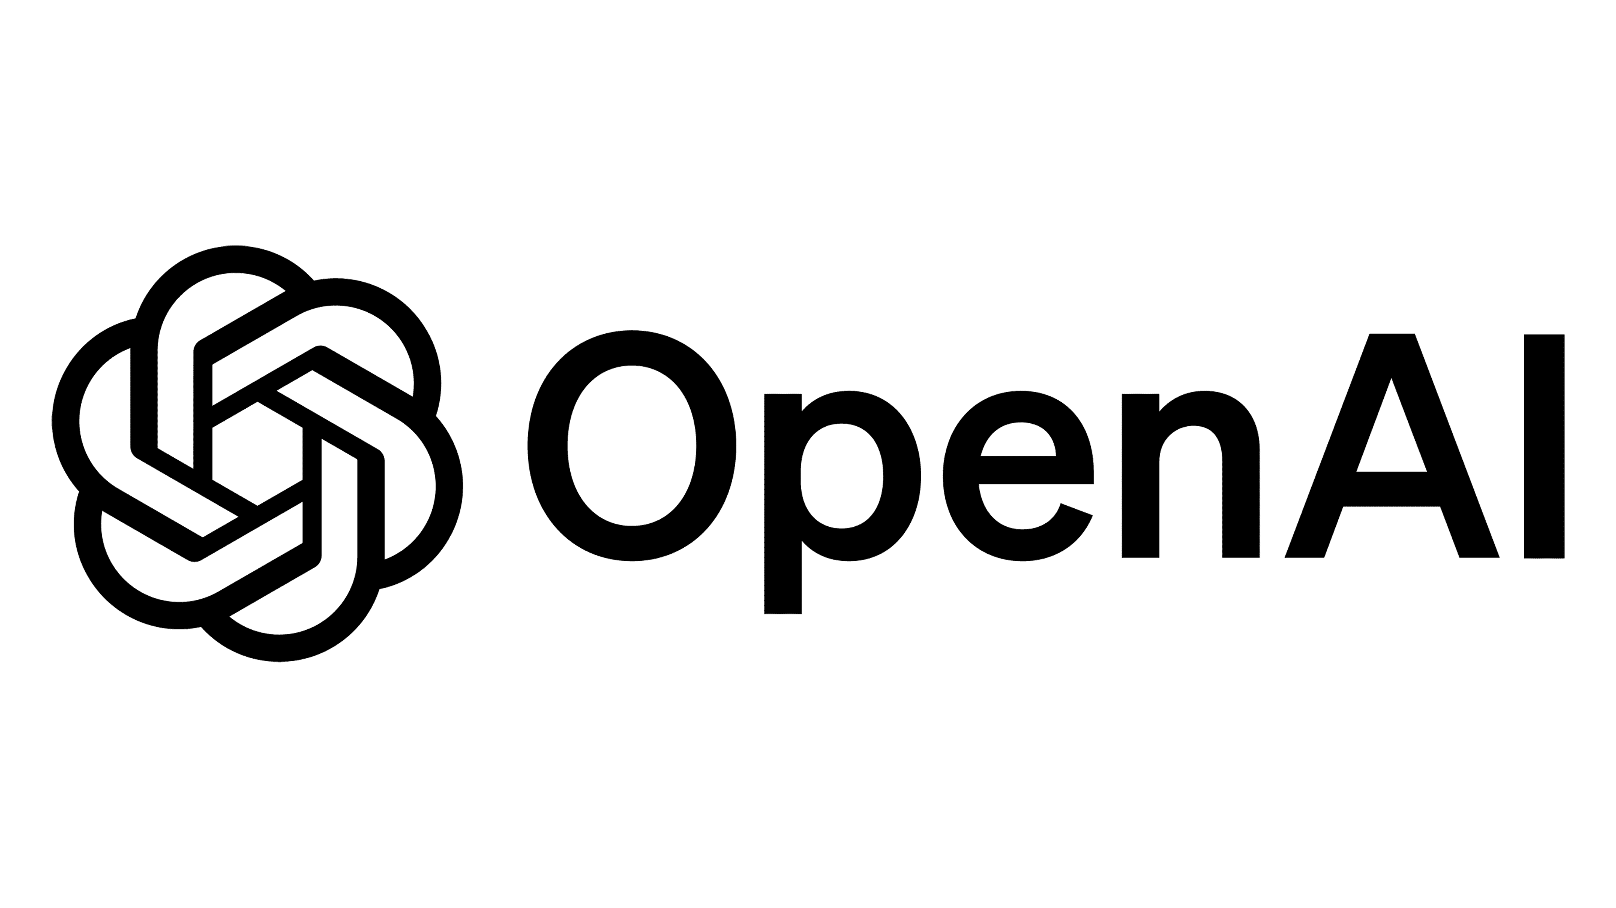
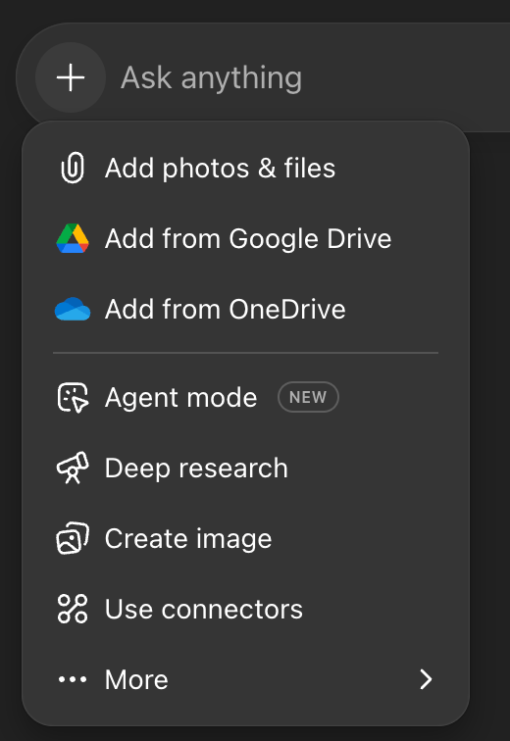
Agents work with tools to take actions on your behalf
Language is an interface.
The answer is not immediate like a chat. It’s important to select the proper tool.

Slide 40
Agentic Prompt: Example 1
(Actual prompt - will show the result at the end)
“I need to know about the enforceability of non-compete agreements in Delaware for mid-level employees in the tech industry. Can you please:
Search recent case law and statutes in Delaware.
Summarize the current legal standard in plain English.
Identify any unsettled issues or conflicting rulings.
Draft a short client-ready memo (3–4 paragraphs) explaining the risks and likely enforceability.
Double-check citations against authoritative sources before finalizing.”
Email the results to these email address (attached Excel sheet)

Slide 41
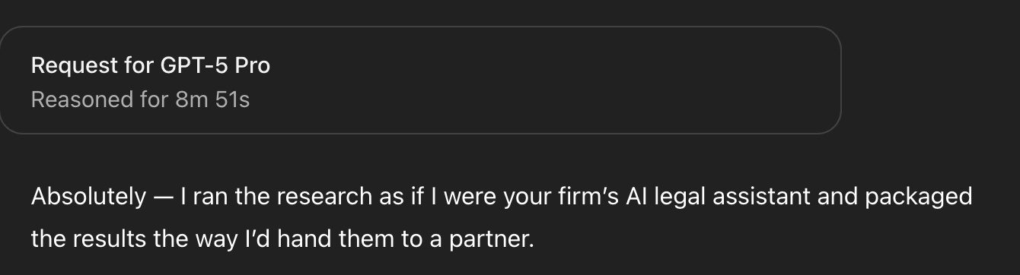
I ran the agentic non-compete example.
GPT-5 Pro thought for 8 minutes and 51 seconds and returned a 7-page report.
I’ve included the results in an appendix at the end of these slides.

Slide 42
Agentic Prompt: Example 2
“You are a trial preparation assistant. I am defending a medical malpractice case in Maryland.
Review the witness list and identify the plaintiff’s expert witnesses.
For each expert, gather prior testimony (from databases, publications, or reported cases) that might be used for impeachment.
Highlight inconsistencies between their past testimony and their current report.
Draft a cross-examination outline with 10–15 key questions per expert, grouped by theme (credentials, methodology, bias, prior inconsistent statements).
Flag any legal risks (e.g., evidentiary objections under Daubert/Frye).
Present the outline in a structured format I can take into court.”

Slide 43
Group question:
“What are ‘prompts’ and do I need to be a “prompt engineer” to use these AI tools?”

Slide 44
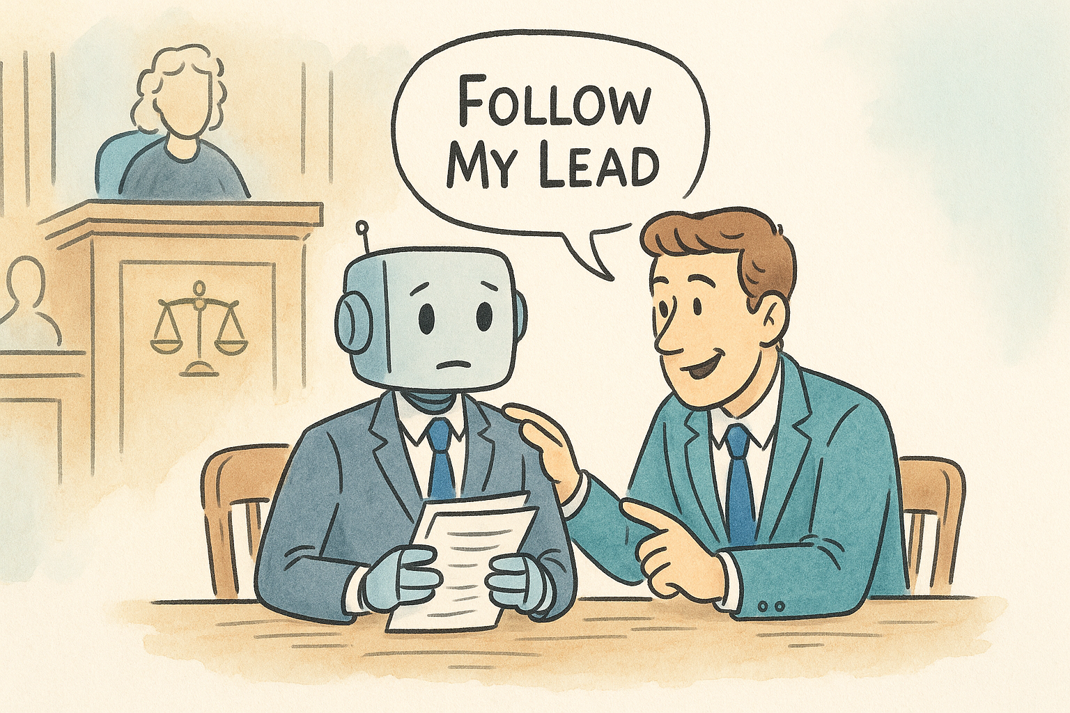
MY PROMPT: “Redo this in the black and white style of the New Yorker”
ACTUAL PROMPT: Single-panel magazine cartoon, black-and-white pen-and-ink with graphite cross-hatching. Courtroom interior: judge on bench in back left (minimal face), scales-of-justice emblem on panel, a few faint gallery silhouettes. Foreground at counsel table: human lawyer in suit smiling and gently coaching a friendly, slightly nervous boxy robot in a suit holding papers. Hand-drawn frame around the scene. Clean white margin BELOW the frame for the caption. Centered caption outside the panel in a classic serif magazine style, EXACT text: “Follow My Lead.” No color, no speech bubbles, crisp linework, tasteful shading, slide-ready, 16:9

Slide 45
“The most obvious, lowest risk way to use AI (and to get a sense of how good it is) is to ask it for second opinions in your area of expertise. This works across most fields. And I’d go further: increasingly, not using AI as a second opinion is going to lead to worse outcomes.”
-Ethan Mollick https://x.com/emollick/status/1924152902907494870

Slide 46
Common question:
“I want to avoid hallucinations so what must I do when using an AI tool to prevent (or minimize) hallucinations?”

Slide 47
AI agent capabilities double every seven months
“Randomized trial AI for legal work finds Reasoning models are a big deal: Law students using o1-preview had the quality of their work on most tasks increase (up to 28%) & time savings of 12-28%. There were a few hallucinations, but a RAG-based AI* reduced those to human level.” -Ethan Mollick, Wharton Business, March 2025
*RAG = Retrieval Augmented Generation
https://ethanbholland.com/category/ai/rag/
“This is the worst it will ever be”

Slide 48
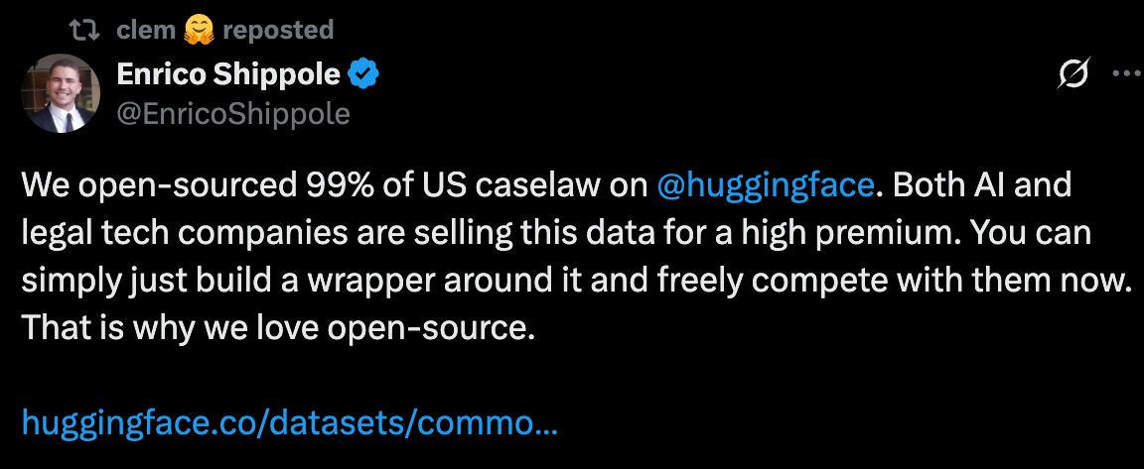
Term FOUR: Open Source
You can download it, modify it, use it for free on your own machine.
The best open source AI is only ~10% behind the strength of the frontier models (GPT, Claude, Gemini).
“Open source” can refer to models and/or publicly available datasets
Impact = fewer moats for legacy software companies
“We open-sourced 99% of US caselaw… You can simply just build a wrapper around it and freely compete.”

Slide 49
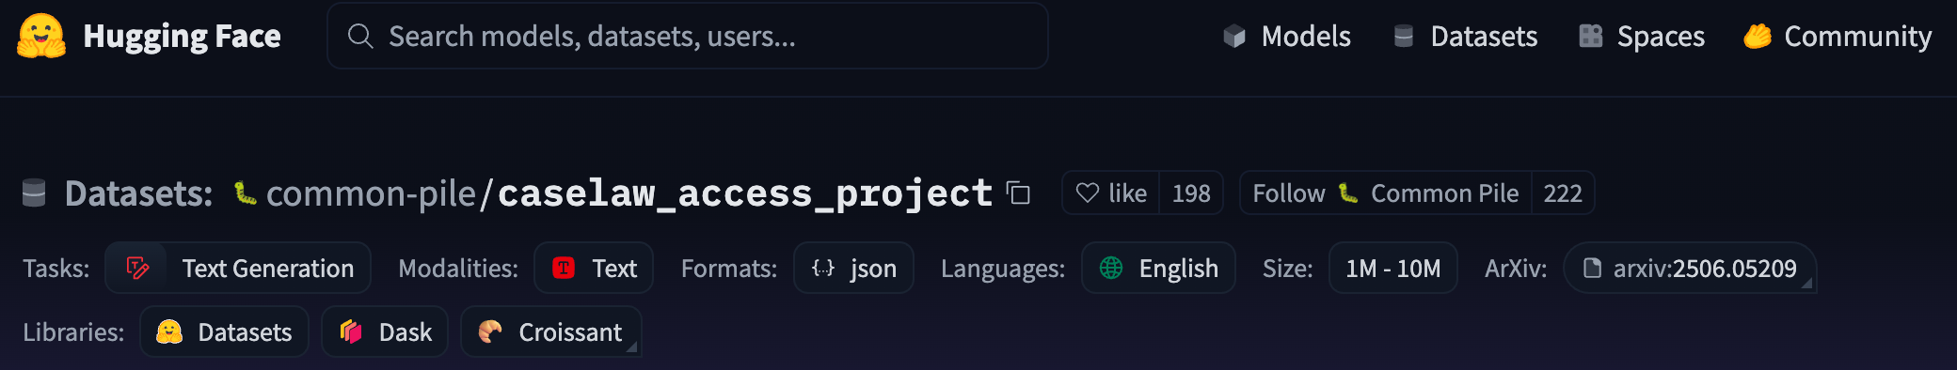
3,898 downloads in August!
“This dataset contains 6.7 million cases from the Caselaw Access Project and Court Listener. The Caselaw Access Project consists of nearly 40 million pages of U.S. federal and state court decisions and judges’ opinions. In addition, Court Listener adds over 900 thousand cases scraped from 479 courts. The Caselaw Access Project and Court Listener source legal data from a wide variety of resources such as the Harvard Law Library, the Law Library of Congress, and the Supreme Court Database. From these sources, we only included documents that were in the public domain. Erroneous OCR errors were further corrected after digitization, and additional post-processing was done to fix formatting and parsing.”
https://huggingface.co/datasets/common-pile/caselaw_access_project

Slide 50
Three Minutes Of Awe
  1) Usage and Milestones
  2) Investment Announcements
I’m putting a lot of information in the slides to read later.
For efficiency… I’m only reading the yellow highlights.

Slide 51
Usage and General Milestones
February 28, 2025
  OpenAI updates GPT 4.5
March 7, 2025
  OpenAI Launches GPT-4.5 with Focus on “Human-Like” Interactions
March 21 2025
  Meta’s open-source model Llama has hit 1 billion downloads.
April 18, 2025
  ChatGPT now has 1 billion weekly active users.
May 02, 2025
  Waymo has reached 250,000 weekly paid robotaxi rides across the United States in four cities.
  Morgan Stanley forecasts 1 billion humanoid robots by 2050.
May 9, 2025
  To test Google Gemini 2.5’s memory, professor Ethan Mollick gave the model the entire text of the novel War and Peace, added a single imposter sentence in varying places, and the model caught it every time.

Slide 52
April 4, 2025
  Google announced that it believes artificial general intelligence (AGI) [superhuman] will arrive within a few years and they’ve started to release documents outlining what they are going to do to mitigate risks to humanity.
  A therapy chatbot out of Dartmouth showed a 51% reduction in depression and 31% reduction in anxiety, which is comparable to traditional therapy yet available 24/7 and never tired or off duty.
April 11, 2025
  ChatGPT can now remember and reference your entire conversation history going back in perpetuity.
  University of California San Diego researchers demonstrated that GPT-4.5 successfully passes the Turing test. The AI system was able to fool 75% of humans into thinking it was human.
April 18, 2025
  OpenAI claims that o3 is capable of generating original ideas.
April 25, 2025
  Demis Hassabis, CEO of Google DeepMind, forecasts that AI will naturally evolve self-awareness within the next 5 to 10 years.

Slide 53
March 28, 2025
  Google came out of nowhere and launched a new version of their Gemini model, and has completely destroyed the competition.
    Gemini is now at the top of the leaderboards in almost every category, with 40-point leads in some cases.
May 02, 2025
  Anthropic doubled down on their prediction that we will get Nobel Prize level artificial intelligence across domains at scale within three years.
May 16, 2025
  Meta hired a new leader of advanced machine intelligence, which is their internal term for AI systems that match or beat human level intelligence across all tasks.
May 30, 2025
  The leading AI models are now outperforming the average human on creativity assessments. They still fall short compared to the most creative humans, but average people are no match for AI in creativity tests.
June 06, 2025
  In Nvidia’s quarterly earnings call, CEO Jensen Huang stated that billions of robots and hundreds of millions of autonomous vehicles will be developed in the near future. Jensen is not a hyperbolic person.

Slide 54
July 11, 2025
  Nvidia became the first company to reach a $4 trillion market value.
June 14, 2025
  OpenAI CEO Sam Altman posted a blog where he states that AI has already passed human capabilities and we’ve begun a “gentle singularity”
  Amazon has created an obstacle course to evaluate robots that they could employ to Rivian delivery vans and start to handle deliveries without humans.
  OpenAI reduced their o3 model pricing by 80% while maintaining the same performance.
July 18, 2025
  Chinese robotics company Unitree hit a $1.4 billion valuation.
  Zuckerberg aims to create AGI in the next two to three years.
  Nvidia launched a new technology that expands the effective context window of language models to entire encyclopedias. This means the same “next token almost instant” response of GPT 4, would be able to digest and reply to a single prompt the size of an encyclopedia… with the same speed as a single sentence prompt.

Slide 55
July 25, 2025
  Anthropic announced that they processed almost one quadrillion tokens last month. That’s double the volume from May.
  ChatGPT is now processing 2.5 billion daily requests worldwide. All of this usage has to be putting a dent in Google searches and web traffic.
  Open AI boldly shared a lofty vision to build an artificial intelligence that will transform humanity into a new era of abundance.
    https://openai.com/index/ai-as-the-greatest-source-of-empowerment-for-all/
August 2, 2025
  OpenAI reached $12 billion in annualized revenue.
  GPT usage has doubled since the summer of 2023, and 28% of employed adults use GPT at work.
  Mark Zuckerberg released a statement about his position regarding Superintelligence.
    https://www.meta.com/superintelligence/
  BUT: Two thirds of US adults have still not used GPT - YOU’RE NOT ALONE
August 8, 2025
  ChatGPT is on track to reach 700 million weekly active users by the end of next week. That’s up from 500 million users at the end of March and four times the weekly users at this time last year.

Slide 56
Now let’s look at investment headlines over the past 6-months.
Again, this is all in chronological order and everything is hand-curated by me.

Slide 57
Investments: AI is not slowing
February 28, 2025
  Alibaba will invest more than $52 billion in AI over next 3 years
  Apple will spend more than $500 billion in the U.S. over the next 4 years
March 7, 2025
  TSMC Expands U.S. Chip Manufacturing with $100 Billion Investment
March 14, 2025
  Meta announced it is going to build its own in-house computing chips for artificial intelligence.
March 28, 2025
  OpenAI is close to completing a $40 billion funding round led by SoftBank that would nearly double OpenAI’s valuation in just six months.
April 4, 2025
  Open AI has secured an unprecedented $40 billion in funding, valuing the business at $300 billion.
  Nvidia is in a bit of a pickle because Alibaba, Tencent, and ByteDance have ordered $16 billion worth of Nvidia chips. Nvidia has to decide whether to ramp up production capacity while risking getting banned from selling to China.

Slide 58
April 18, 2025
  Nvidia announced plans to build $500 billion worth of AI servers in the US.
  OpenAI’s cofounder Ilya Sutskever’s company has reached a $32 billion valuation without a product.
May 23, 2025
  OpenAI has partnered with the United Arab Emirates to build the first international deployment of its massive Stargate AI infrastructure platform.
June 06, 2025
  Meta signed a 20 year nuclear deal to power their AI operations. Meta will be consuming the power equivalent of a city with 30,000 residents.
June 14, 2025
  Meta is offering over $2 million annually to AI talent, with some packages reaching $10 million per year for its new “superintelligence” team, but still losing candidates to OpenAI and Anthropic.
  Meta invested $15 billion in data training company Scale AI, and as part of the deal, Scale’s CEO Alexandr Wang is joining Meta as part of the super-intelligence team.
  Qualcomm purchased a British semiconductor company called Alphawave for $2.4 billion in cash.

Slide 59
June 20, 2025
  SoftBank pitched a $1 trillion artificial intelligence hub in Arizona.
July 4, 2025
  Oracle and OpenAI have signed an agreement, as part of their Stargate project, to develop a data center with 4.5 gigawatts capacity in the United States.
  Amazon deployed its 1 millionth robot across 300 facilities worldwide and developed an AI system that manages robot movements and can reduce robot travel time by 10%.
  Meta officially established their super intelligence lab division hiring at least 11 researchers from AI companies, including OpenAI Google and Anthropic. These 11 hires have been offered compensation packages worth up to $300 million each with at least one recruit’s first year compensation exceeding $100 million!
July 11, 2025
  Amazon is considering investing several more billion dollars in Anthropic. They already invested $8 billion last year.
  Google ended up hiring the Windsurf team after OpenAI’s $3 billion acquisition attempt fell through.

Slide 60
July 18, 2025
  Google announced a $25 billion investment in AI infrastructure in the United States over the next two years.
  President Trump announced over $90 billion in private sector investments in the state of Pennsylvania. A single state! $90 billion. That’s in addition to Amazon’s previous $20 billion investment in the state.
  Mark Zuckerberg announced that Meta would invest hundreds of billions of dollars in data center spending. One of the data centers will be the size of Manhattan.
  Meta completed its three week hiring blitz (with $100 million signing bonuses) and officially announced its new AI lab. Two of the hires are poached employees from OpenAI.
  Oracle announced it will invest $3 billion in Europe over the next five years. Total 2026 cap ex for Oracle is expected to exceed $25 billion. On top of that, Oracle announced a private unnamed deal in 2028 with a single client spending $30 billion.
  The former OpenAI CTO and a few other ex-OpenAI employees (mostly the board shake-up Sam Altman ouster team) have raised $2 billion for their new company, Thinking Machines. It’s the largest seed round of funding in history. The niche appears to be multimodal audio and visual engineering.

Slide 61
July 18, 2025 (continued)
  Elon Musk continues to pivot all of his combined company power to bolstering his AI training goals. SpaceX is investing $2 billion in xAI. Tesla shareholders may vote soon re whether Tesla should also invest. Musk is integrating his Grok LLM across his products in an attempt to blur the lines and enable cross company investment.
  Microsoft is teaming up with Idaho National Laboratory (a very fun place to visit if you’re into history) to use AI to speed up the paperwork for nuclear power permits. This is directly related to the need/desire to create more electricity as quickly as possible to power data centers.
  Anthropic is looking to raise new funding that would value the company at $100 billion.

Slide 62
July 25, 2025
  Meta continues to poach OpenAI researchers, however information came out that at least ten OpenAI employees rejected $300 million offers from Mark Zuckerberg. Clearly these folks have faith in their product roadmap. To me, this is a poker tell that OpenAI has a plan.
  Meta plans to build two enormous data centers, one in Louisiana and Ohio. The Louisiana facility will have one gigawatt of power and the Ohio center will have 5 gigawatts of power. In order to bring the facilities to market even more quickly Meta is using tents as temporary structures as the buildings are constructed.
  Anthropic published a report this week as well arguing that the United States needs to make significant investments in energy in order to stay ahead in artificial intelligence.
  Google reached an agreement to generate 3,000 megawatts of hydroelectric power.
  OpenAI and Oracle announced they are expanding their Texas Stargate data center project and will increase capacity to over 5 gigawatts across the United States.
  OpenAI expects to bring a total of over 1 million GPUs online before the end of this year. Sam Altman tweeted that he aims to reach 100 million.
  The University of Bristol in the United Kingdom launched the UK’s most powerful artificial intelligence computer, which can perform 21 trillion operations per second.

Slide 63
August 8, 2025
  The seven largest technology companies spent over $100 billion on AI infrastructure in the past three months; that’s more than all U.S. consumer spending combined in the last six months.
  Meta is selling $2 billion in assets to help pay for its new data center infrastructure and growth.
  OpenAI is reportedly working on a secondary sale that values the company at $500 billion.
  Google created an AI for education accelerator that provides free AI training and career certificates to college students in the United States. This includes a $1 billion commitment to AI literacy.

Slide 64
“If AI development stopped this week we would have 5-10 years of absorbing the impact of current models on education, culture, healthcare, and business.”
-Wharton professor Ethan Mollick

Slide 65
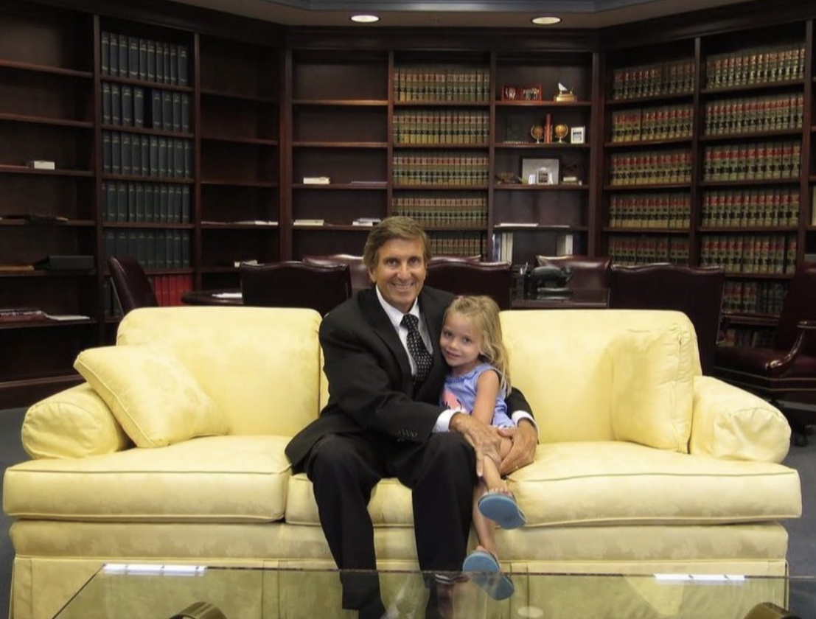
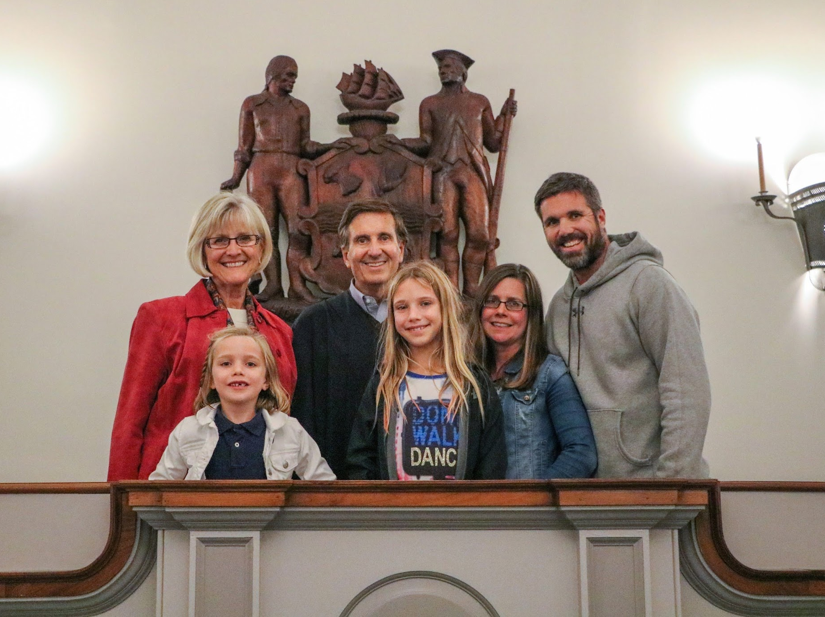
Open Discussion and Q&A
Following this slide are all the resources you need to be fully informed!
Agentic law research result (from our example today)
Legal AI tools (branded products)
Six-month recaps by topic:
  Legal AI news
  Imagery
  Video
  Multimodal
  Agents
  The Internet and websites
Nothing beats human relationships!
https://randyjholland.com/

Slide 66
Appendix 1: Legal Agent Result

Slide 67
I ran the agentic non-compete example on GPT-5 Pro.
GPT-5 Pro thought for 8 minutes and 51 seconds and returned a 7-page report. You can check its work later and get back to Richard.

Slide 68
TL;DR (for the room)
Delaware still enforces employee non‑competes, but only when they’re narrowly tailored to a legitimate business interest (e.g., trade secrets, client goodwill), with reasonable scope and duration, and the court is increasingly unwilling to “blue‑pencil” overbroad clauses. Delaware Courts+1
Statutes: Delaware has no general ban for tech workers; physician non‑competes are void by statute. Choice‑of‑law clauses favoring Delaware are statutorily supported but not bullet‑proof if another state’s policy has a materially greater interest. Delaware Code+2Justia Law+2
Recent cases (2023–2025) show a trend against broad, nationwide, “any job at any competitor” restrictions; courts declined to rewrite them. Delaware Courts+1
“Employee‑choice” forfeiture (lose equity/cash if you compete) is distinct from a flat work ban and, after Ainslie and LKQ, can be enforced without reasonableness review in many contexts—though boundaries remain. Delaware Courts+1
FTC national rule banning non‑competes is not in effect; a federal court set it aside and the FTC has taken steps to dismiss its appeal. Delaware law governs. Federal Trade Commission

Slide 69
Plain‑English: the current Delaware standard
A Delaware employment non‑compete is enforceable if the employer proves it (1) protects a legitimate economic interest (e.g., confidential information, customer relationships, acquired goodwill), (2) is reasonable in scope (what roles/functions are barred and where), (3) is reasonable in time, and (4) is equitable to enforce on these facts. The court looks at how the restrictions operate in practice, not just how they’re drafted. Overbreadth sinks the clause; judges won’t rescue it for you. Delaware Courts+1
No blue‑pencil trend: The Delaware Supreme Court affirmed Chancery’s refusal to “blue‑pencil” facially overbroad covenants; if the clause is too broad, expect no court‑ordered rewrite. Delaware Courts
Legitimate interest is cabined: In agreements tied to a business sale, Delaware has emphasized the interest is the goodwill actually purchased—you can’t use a non‑compete to block ordinary competition beyond that.
Examples of overbreadth: Courts have rejected nationwide or any‑capacity bars, and provisions untethered to the employee’s actual customers/markets. Delaware Courts
Statutes that matter
Physicians: Non‑competes between/among physicians are void (damages clauses may still be enforceable). (6 Del. C. § 2707.) Delaware Code
Choice of law: Delaware permits parties to choose Delaware law (6 Del. C. § 2708), but Chancery may decline to apply it where another state has a fundamental policy and materially greater interest in the dispute (seen in recent employment cases). Justia Law+1
Federal overlay
The FTC’s April 2024 non‑compete ban never took effect; a Texas federal court set it aside and, as of Sept. 5, 2025, the FTC has moved to dismiss its appeal. Delaware’s common‑law rules control. Federal Trade Commission

Slide 70
Recent Delaware decisions (what they actually did)
Sunder Energy, LLC v. Jackson (Del. Supr. June 10, 2024): Supreme Court affirmed denial of a preliminary injunction; covenants were facially unreasonable and the court declined to blue‑pencil. Clarifies the judiciary’s reluctance to rewrite overbroad restraints. Delaware Courts
Kodiak Building Partners v. Adams (Del. Ch. Oct. 6, 2022): In a sale‑of‑business setting, the court refused to rewrite an overbroad non‑compete and limited the legitimate interest to purchased goodwill. (Still cited post‑2022.)
Intertek Testing Services NA, Inc. v. Eastman (Del. Ch. Feb. 14, 2023): Court declined to “blue‑pencil” an overbroad restraint; preference is to enforce or not, not to re‑draft.
Centurion Service Group v. Wilensky (Del. Ch. Aug. 31, 2023): Court refused a nationwide non‑compete, emphasized reasonableness, and—importantly—declined to apply Delaware law despite a Delaware choice‑of‑law clause, given another state’s stronger policy interest. Delaware Courts
Payscale, Inc. v. (former sales director) (Del. Ch. May 27, 2025): Court found the non‑compete unreasonable in scope and unenforceable; additional claims failed. Delaware Courts
PSH/“maximum enforceable” clauses (Del. Ch. June 27, 2025): Court addressed agreements that say overbroad covenants should be enforced to the “maximum reasonable” extent; the opinion underscores that such boilerplate does not guarantee judicial reformation. Delaware Courts
Cantor Fitzgerald, L.P. v. Ainslie (Del. Supr. Jan. 29, 2024): Forfeiture‑for‑competition in a limited partnership agreement enforced based on freedom‑of‑contract—not subject to reasonableness review (distinct from a traditional work ban). Delaware Courts
LKQ Corp. v. Rutledge (7th Cir. Jan. 22, 2025, after Del. Supr. Dec. 18, 2024): Following certified questions to the Delaware Supreme Court, the Seventh Circuit held forfeiture‑for‑competition provisions in RSU agreements are enforceable under Delaware law without reasonableness review. (Contrast with flat non‑compete clauses.) media.ca7.uscourts.gov

Slide 71
What’s unsettled or in flux (and why it matters)
How far “employee‑choice” forfeiture travels
Delaware has green‑lit forfeiture‑for‑competition in LP agreements and, post‑LKQ, equity/RSU settings. It’s still developing how far that extends across different employee levels, involuntary separations, or where the forfeiture resembles a penalty. Expect litigation around unconscionability/bad faith exceptions. Delaware Courts+1
Blue‑pencil vs. severability boilerplate
Multiple opinions signal courts will not rewrite sweeping clauses despite “maximum enforceable” language. Overbreadth risks total loss. Draft precisely the first time. Delaware Courts+1
Choice‑of‑law workarounds
Even with § 2708 and a Delaware forum, Chancery can decline Delaware law when another state’s fundamental policy and material interest dominate (common with out‑of‑state, remote tech workers). Plan for the most restrictive law that could apply. Justia Law+1
Scope in modern tech roles
Nationwide, “any role with any competitor” and “all customers (including prospects/affiliates)” language is drawing close scrutiny. Target specific competitors, product lines, and channels, and tie the scope to what the employee actually did. Delaware Courts
Interaction with consideration
Equity‑based consideration and forfeitable grants are under the microscope. Opinions and 2025 rulings scrutinize whether consideration really persists when awards are unvested/forfeitable. Conservative approach: give fresh, non‑illusory consideration at signing. Delaware Courts

Slide 72
Short client‑ready memo (3–4 paragraphs)
Issue & standard. Delaware law will enforce a non‑compete against a mid‑level tech employee only if it is narrowly tailored to protect legitimate business interests (e.g., trade secrets, confidential roadmaps, key client goodwill), with reasonable function, geography, and duration, and if enforcement is equitable on these facts. Over the last two years, Delaware courts—and the Delaware Supreme Court—have declined to “blue‑pencil” overbroad clauses; if a covenant reads too broadly on its face, the remedy is typically non‑enforcement, not judicial redrafting. Delaware Courts+1
Risk assessment. For a typical mid‑level engineer, product manager, or sales lead, a clause barring work for “any competitor, in any role, nationwide” for a year or two is unlikely to hold in Delaware absent a strong, specific justification (e.g., the employee managed defined strategic accounts or core IP). Non‑solicitation and confidentiality provisions, carefully tied to customers the employee actually served or information actually accessed, fare better. Where equity is involved, consider separating forfeiture‑for‑competition (which Delaware has enforced as a contract remedy) from a flat employment ban, and expect courts to probe fairness if the facts suggest penalty‑like outcomes. Delaware Courts+2Delaware Courts+2
Drafting & enforcement posture. To maximize enforceability, (i) define “competitor” concretely (or list them), (ii) limit functional scope to roles that would exploit your secrets/goodwill, (iii) right‑size geography (markets where the employee actually operated), and (iv) cap duration to what you can justify. Provide real consideration (e.g., a retention bonus/garden leave or a new equity grant) at signing. Avoid “maximum enforceable” filler and broad affiliate/”prospects” definitions; those are frequently criticized. If the worker sits outside Delaware, account for choice‑of‑law risk—Delaware’s § 2708 helps, but Chancery can still defer to a stricter local policy. Delaware Courts+2Delaware Courts+2
Bottom line. Properly narrow non‑competes can still be enforced in Delaware, but the trend is skeptical of aggressive restraints in the employment context. For most mid‑level tech roles, a targeted non‑solicit + confidentiality package, coupled with forfeiture‑for‑competition on meaningful equity/cash, often delivers better protection with lower litigation risk. The FTC’s attempted federal ban is not operative, so Delaware case law governs—for now. Federal Trade Commission

Slide 73
Key primary authorities (with one‑line “why it matters”)
Sunder Energy, LLC v. Jackson (Del. Supr. 2024) — No blue‑pencil for facially overbroad covenants; confirms the modern enforcement posture. Delaware Courts
Kodiak Building Partners v. Adams (Del. Ch. 2022) — Legitimate interest tied to purchased goodwill; court refused to rewrite overbroad language.
Intertek Testing Services v. Eastman (Del. Ch. 2023) — Declined to reform unreasonable sale‑of‑business restraints.
Centurion Service Group v. Wilensky (Del. Ch. 2023) — Struck a nationwide non‑compete; also rejected Delaware law despite a choice‑of‑law clause. Delaware Courts
Payscale (Del. Ch. 2025) — Non‑compete unreasonable in scope; claims dismissed. Delaware Courts
Cantor Fitzgerald, L.P. v. Ainslie (Del. Supr. 2024) — Forfeiture‑for‑competition in an LP agreement enforced sans reasonableness review. Delaware Courts
LKQ Corp. v. Rutledge (7th Cir. 2025 after Del. Supr. 2024) — Confirms employee‑choice forfeiture in RSU context under Delaware law. media.ca7.uscourts.gov
6 Del. C. § 2707 — Physician non‑competes are void (narrow industry carve‑out). Delaware Code

Slide 74
One‑slide checklist you can read in court (what to ask about your clause)
What are we protecting? (named products/secrets; named customer sets)
Who is the “competitor”? (list or market definition, not “any competitor”)
Which roles are barred? (tie to employee’s actual role/knowledge)
Where? (actual territories served; remote work nuance)
How long? (only as long as secrets are “hot” or goodwill is at risk)
What’s the consideration? (fresh compensation; garden leave; equity)
What law will really apply? (employee’s state policy may trump § 2708)
Quick note on the FTC rule (for Q&A)
The FTC’s April 2024 final rule banning most non‑competes was set aside by the Northern District of Texas on August 20, 2024; as of September 5, 2025, the FTC reports the rule is not in effect and has taken steps to dismiss its appeal. Your analysis should proceed under Delaware law unless and until federal law changes. Federal Trade Commission

Slide 75
Appendix 2: Legal Tools

Slide 76
Legal research & AI assistants
Generative AI Legal Research | Westlaw Precision | Thomson Reuters
https://legal.thomsonreuters.com/en/products/westlaw-precision
Lexis+ AI | Legal AI for Drafting, Research, & Analysis | LexisNexis
https://www.lexisnexis.com/en-us/products/lexis-plus-ai.page
Vincent AI | Legal AI Engineered for Lawyers | vLex
https://vlex.com/vincent-ai
CoCounsel Legal - AI Legal Assistant | Thomson Reuters
https://legal.thomsonreuters.com/en/products/cocounsel-legal
Harvey
https://www.harvey.ai/

Slide 77
Brief & citation analysis / writing
Bloomberg Law - Brief Analyzer
https://pro.bloomberglaw.com/products/ai-and-bloomberg-law
Quick Check - Westlaw Edge | Thomson Reuters
https://legal.thomsonreuters.com/en/products/westlaw-edge/quick-check
Litigation Document Review Software | Lexis+
https://www.lexisnexis.com/en-us/products/lexis-plus/document-analysis/brief-analysis.page
Clearbrief
https://clearbrief.com/

Slide 78
eDiscovery & investigations
Relativity: Artificial Intelligence for e-Discovery
https://www.relativity.com/artificial-intelligence/
Reveal: Attain optimal, AI-driven eDiscovery
https://www.revealdata.com/
Cecilia AI: Legal AI Tools | DISCO
https://csdisco.com/offerings/cecilia
Everlaw AI Assistant
https://www.everlaw.com/product/everlaw-ai-assistant/

Slide 79
Contracting & CLM (review, drafting, analytics)
Contract Pod AI
https://contractpodai.com/
Legal AI for Contract Review | LegalOn
https://www.legalontech.com/review
Henchman | AI Contract Drafting and Legal DMS Integration | LexisNexis
https://www.lexisnexis.com/en-us/products/henchman.page
Legal AI Contract Review & Drafting | Spellbook
https://www.spellbook.legal/
Robin | Legal AI | AI-Powered Contract Software
https://robinai.com/
Luminance - Legal-Grade™ AI
https://www.luminance.com/

Slide 80
Contracting & CLM (review, drafting, analytics) continued…
Vera Copilot: Unlock Agentic Contract Efficiency | Icertis
https://www.icertis.com/products/platform/copilot/
Generative AI Contract Management | AI Redlining Software
https://www.agiloft.com/solutions/ai-platform/
Workday Contract Intelligence, powered by Evisort AI | Workday US
https://www.workday.com/en-us/products/contract-management/contract-intelligence.html
Sirion: The leader in AI Contract Management Software
https://www.sirion.ai/
Ironclad: Contract Management Software Powered by AI
https://ironcladapp.com/

Slide 81
Litigation analytics & prediction
Pre/Dicta: Predict the course and outcome of litigation with proprietary legal intelligence
https://www.pre-dicta.com/
Lex Machina Legal Analytics Software | LexisNexis
https://www.lexisnexis.com/en-us/products/lex-machina.page
Litigation Analytics - Westlaw Edge | Thomson Reuters
https://legal.thomsonreuters.com/en/products/westlaw-edge/litigation-analytics
AI-Driven Legal Research and Tools - Bloomberg Law - Litigation Analytics
https://pro.bloomberglaw.com/products/ai-and-bloomberg-law

Slide 82
Plaintiff-side tools (case origination, demands)
EvenUp | Personal Injury AI — From Intake to Resolution
https://www.evenuplaw.com/
Darrow AI - Be the first to discover, assess and address emerging legal risks
https://www.darrow.ai/
Practice management with embedded AI
Message from 8am MyCase AI Assistant
https://www.mycase.com/products/legal-ai-software/
Clio Duo: Your Legal AI Partner | Best AI Tool for Lawyers | Clio
https://www.clio.com/features/legal-ai-software/
Legal AI Software for Law Firms | Smokeball
https://www.smokeball.com/smokeball-ai
Legal Practice Management Software for Law Firms | Filevine
https://www.filevine.com/

Slide 83
Timekeeping & legal ops / spend
Laurel AI: Automate timesheets. Save hours. Increase leverage.
https://www.laurel.ai/
Legal spend management: e-billing and matter management
https://brightflag.com/
Automation, client intake & chat
Gavel | Document Automation Software for Legal Professionals
https://www.gavel.io/
Josef | Legal AI that drives the business
https://joseflegal.com/
LawDroid. Work Smarter With AI Legal Assistants. | LawDroid
https://lawdroid.com/

Slide 84
Timekeeping & legal ops / spend
Laurel AI: Automate timesheets. Save hours. Increase leverage.
https://www.laurel.ai/
Legal spend management: e-billing and matter management
https://brightflag.com/
Automation, client intake & chat
Gavel | Document Automation Software for Legal Professionals
https://www.gavel.io/
Josef | Legal AI that drives the business
https://joseflegal.com/
LawDroid. Work Smarter With AI Legal Assistants. | LawDroid
https://lawdroid.com/
IP / patents
PatentPal
https://patentpal.com/

Slide 85
Access Projects and Legal Aid
AI can narrow justice gap, but women lawyers slower to adopt it, Berkeley study shows | Reuters
https://www.reuters.com/legal/transactional/ai-can-narrow-justice-gap-women-lawyers-slower-adopt-it-berkeley-study-shows-2024-03-21/
AI for Legal Aid: How to supercharge legal services organizations - Thomson Reuters Institute
https://www.thomsonreuters.com/en-us/posts/legal/ai-legal-aid-service-organizations/
AI Chatbot Development Update: Enhancing Access to Justice Through Technology - Lone Star Legal Aid
https://www.lonestarlegal.org/news/2025/04/ai-chatbot-development-update-enhancing-access-to-justice-through-technology/
Juris: The Legal Research Chatbot | LSC - Legal Services Corporation: America's Partner for Equal Justice
https://www.lsc.gov/i-am-grantee/model-practices-innovations/technology/juris-legal-research-chatbot
[2502.16573] LawPal : A Retrieval Augmented Generation Based System for Enhanced Legal Accessibility in India
https://arxiv.org/abs/2502.16573
JusticeText rolls out AI-powered bodycam transcription for Kentucky public defenders
https://justicetext.com/kentucky-dpa/
The Office of the Colorado State Public Defender Conquer Evidence Overload With AI Transcription Of Video Discovery Footage
https://reduct.video/case-studies/colorado-public-defenders
Miami-Dade Public Defender is using artificial intelligence for research and case preparation – The Florida Bar
https://www.floridabar.org/the-florida-bar-news/miami-dade-public-defender-is-using-artificial-intelligence-for-research-and-for-case-preparation/

Slide 86
Access Projects and Legal Aid (continued)
LegalServer - Smarter Case Management Software for Civil Legal Aid and Public Defenders
https://www.legalserver.org/
Federal Defender's Program - Sentencing Stats
https://www.sentencingstats.com/federal-defenders-program/
Real AI Solutions for Attorneys - Matey AI
https://www.matey.ai/
Generative AI and Legal Aid: Results from a Field Study and 100 Use Cases to Bridge the Access to Justice Gap by Colleen V. Chien, Miriam Kim :: SSRN
https://papers.ssrn.com/sol3/papers.cfm?abstract_id=4733061&utm_source=chatgpt.com
[2410.17210] Exploring Possibilities of AI-Powered Legal Assistance in Bangladesh through Large Language Modeling
https://arxiv.org/abs/2410.17210
[2502.16573] LawPal : A Retrieval Augmented Generation Based System for Enhanced Legal Accessibility in India
https://arxiv.org/abs/2502.16573
E-research library with AI tools to assist lawyers | Delhi News - Times of India
https://timesofindia.indiatimes.com/city/delhi/e-research-library-with-ai-tools-to-assist-lawyers/articleshow/122348095.cms
Legal Aid of WV receives grant to develop AI tools that help residents access legal info • West Virginia Watch
https://westvirginiawatch.com/briefs/legal-aid-of-wv-receives-grant-to-develop-ai-tools-that-help-residents-access-legal-info/

Slide 87
Appendix 3: Six-month Legal Links and Milestones

Slide 88
Legal AI Milestones w/ Links
Jan 10, 2025
“Working paper argues AI creates an “inflection point” for each job type. Before that, AI boosts freelancer earnings (web devs saw a +65% increase). After, AI replaces freelancers (translators saw -30% drop). They suggest that once AI starts replacing a job, it doesn’t go back.
https://x.com/emollick/status/1875975178041389547
Jan 17, 2025
Wall Street Expected to Shed 200,000 Jobs as AI Erodes Roles – Bloomberg
https://www.bloomberg.com/news/articles/2025-01-09/wall-street-expected-to-shed-200-000-jobs-as-ai-erodes-roles
“Harvey, the AI for law firms, is raising another round from Sequoia ($300M at $3B). Last round was Series C in July, $100M at $1.5B led by GV. They were estimated to have $30M of revenue then, wonder what revenue looks like now” / X
https://x.com/pitdesi/status/1879982274831347890?s=46

Slide 89
Jan 24, 2025
AI tool can give ministers ‘vibe check’ on whether MPs will like policies | Artificial intelligence (AI) | The Guardian
https://www.theguardian.com/technology/2025/jan/20/ai-tool-can-give-ministers-vibe-check-on-whether-mps-will-like-policies
UK uses AI to tackle ‘bid-rigging’ collusion in public procurement contracts | TechCrunch
https://techcrunch.com/2025/01/06/uk-uses-ai-to-tackle-bid-rigging-collusion-in-public-procurement-contracts/
Jan 30, 2025
Law School (Case Western Reserve University School of Law) Now Requires Students To Get Artificial Intelligence Certification – Above the Law
https://abovethelaw.com/2025/01/law-school-now-requires-students-to-get-artificial-intelligence-certification/
“I think a lot of people on this site underestimate the suspicion with which General Counsel’s offices already view LLMs. I bet that there will be a reluctance in US firms to adopt or use DeepSeek even if it is the best open, local model as they are worried about unspecified risks” / X
https://x.com/emollick/status/1883572124801200311

Slide 90
Copyright and Artificial Intelligence, Part 2 Copyrightability Report
https://copyright.gov/ai/Copyright-and-Artificial-Intelligence-Part-2-Copyrightability-Report.pdf
“Really good to see the Copyright Office moving towards understanding the full extent of what AI tools can offer to the industry. “The use of AI tools to assist rather than stand in for human creativity does not affect the availability of copyright protection for the output,”” / X
https://x.com/c_valenzuelab/status/1884638441008181573
“This is a huge victory for A.I. Filmmakers across the world. The Copyright Office has officially declared what I’ve been preaching for so long. Work that has been manipulated and transformed by humans is indeed copyrightable, even if the tools used were rooted in A.I. . This is a” / X
https://x.com/NemPerez/status/1884659054863077669
Feb 07, 2025
Copyright Office Offers Assurance on AI Filmmaking Tools
https://variety.com/2025/biz/news/copyright-ai-tools-filmmaking-studios-office-1236288969/
US Copyright Office rules out copyright for AI created content without human input | TechSpot
https://www.techspot.com/news/106562-us-copyright-office-rules-out-copyright-ai-created.html
“The US Copyright office has ruled that AI/human combined work can be copyrighted as long as a human is adding, changing or selecting elements. Prompts alone do not usually produce copyrighted work. Everything is case-by-case, but the report is clear and thoughtful about reasoning
https://x.com/emollick/status/1884956650919887327

Slide 91
Feb 14, 2025
Australian lawyer caught using ChatGPT filed court documents referencing ‘non-existent’ cases | Australia news | The Guardian https://www.theguardian.com/australia-news/2025/feb/01/australian-lawyer-caught-using-chatgpt-filed-court-documents-referencing-non-existent-cases
Feb 27, 2025
“I built a multi-agent framework that pre-approves loan applications in under 5 minutes 🎉 1. Integrated 5 agents that make use of @Experian and @Plaid APIs for real-time credit and financial verification 2. The agents look up credit score, DTI, LTV, assets, property valuation https://x.com/n_sri_laasya/status/1890132203419627562
“Last week, @NWischoff asked for an “AI agent to underwrite a mortgage or even do a partially underwritten pre-approval in less than 24 hours.” @AgentOpsAI build a fully functional agent that pre-approves loan applications in under 5 minutes. Comment below if you are interested https://x.com/AtomSilverman/status/1891965335169008133
The Augmented Intelligence Era: Unlocking Unlimited Potential for the Future of Legal Work with Eudia https://www.eudia.com/blog/the-augmented-intelligence-era-unlocking-unlimited-potential-for-the-future-of-legal-work-with-eudia
“Deep Research as a small business incorporation legal consultant. Usually charged hundreds or even thousands of dollars an hour to offer this. Now free, only on Perplexity. https://x.com/AravSrinivas/status/1891563239240069245

Slide 92
“Harvey is THE vanguard AI app startup @NoPriorsPod w/ Cofounder-CEO @winstonweinberg on: *capability improvement *co-pilots, end to end task completion, and product strategy for AI apps *selling AI to enterprise *hiring philosophy *what lawyers do in 5 years links 👇 https://x.com/saranormous/status/1890437612327874751
“so. this will never* happen because law firms have to be owned 100% by attorneys. so it’s impossible* to make a law firm that is also a tech company that rewards non-lawyers with equity” / X https://x.com/andersonbcdefg/status/1891329620558983633
“I think this is directionally accurate tbh I am increasingly bearish on service companies (consulting/accounting/law firms) increasing their margins and becoming more akin to software companies” / X
https://x.com/finbarrtimbers/status/1891308159530082315
“put differently if Harvey (WLOG) is actually the future of law (which I largely believe) the natural conclusion is to launch their own law firm and dominate the vertical” / X https://x.com/finbarrtimbers/status/1891308426841461054
“Representative survey of US workers finds that GenAI use continues to grow: 30% use GenAI at work, 1/3 of those use it every day And the productivity gains appear large: workers report that when they use AI it triples their productivity (reduces a 90 minute task to 30 minutes) https://x.com/emollick/status/1890236327582658595

Slide 93
Surprise Move: Judge Walks Back AI Copyright Ruling in Thomson Reuters v. ROSS | BakerHostetler – JDSupra
https://www.jdsupra.com/legalnews/surprise-move-judge-walks-back-ai-6219521/
Feb 28, 2025
Dench.com is transforming legal lead qualification with AI voice agents. They offer real-time lead qualification, 24/7 availability, and seamless CRM integration at a fraction of the cost.
https://www.ycombinator.com/launches/Mr3-dench-com-ai-intake-for-law-firms
March 07, 2025
“Perplexity deep research just got me out of a $160 speeding ticket I had perplexity come up with a defence for my automatic speeding camera ticket based on local traffic laws and the documents they had mailed to me I read the image below and it worked (not legal advice) https://x.com/AtomSilverman/status/1895195144951079318
“notaries are the purest example of a rent seeking BS job that solely exists due to regulations & bullshit jobs are mostly immune to AI. we might actually instead see the “notarization” of other jobs to protect them from AI disruption ie regulations requiring humans in the loop” / X https://x.com/fabianstelzer/status/1897882991184994444

Slide 94
“Randomized trial AI for legal work finds Reasoning models are a big deal: Law students using o1-preview had the quality of their work on most tasks increase (up to 28%) & time savings of 12-28%. There were a few hallucinations, but a RAG-based AI reduced those to human level. https://x.com/emollick/status/1896625618877583431
March 14, 2025
Introducing Harvey Agents
https://x.com/harvey__ai/status/1899491666429632907
“Harvey released Workflows AI agents for legal tasks, with reasoning, planning, and adapting capabilities In blind reviews, lawyer evaluators rated legal work produced by workflow agents as equal to or better than that of human lawyers
https://x.com/rowancheung/status/1899713342484173043
Judge allows authors’ AI copyright lawsuit against Meta to move forward | TechCrunch https://techcrunch.com/2025/03/08/judge-allows-authors-ai-copyright-lawsuit-against-meta-to-move-forward/
March 21, 2025
“I just build notice explainer ai using @lovable_dev I built this to make sense of confusing tax notices that needs a clear breakdown. You can try it free with 5 credits, and I’d love your feedback! Also, feel free to test it on any kind of document—not just tax notices.” / X https://x.com/abhirb/status/1900173948794409074

Slide 95
April 11, 2025
“I built a web app using @lovable_dev that leverages AI trained in Nigerian Tenancy Law to: ✅ Inform tenants & landlords about their rights ⚖️ Connect users with real lawyers for dispute resolution 💰 Enable rent payments & property management
https://x.com/boysod_/status/1906760339158343764
April 18, 2025
Transforming government service delivery in Abu Dhabi with LangGraph
The Abu Dhabi government's AI Assistant, TAMM 3.0, now delivers 940+ services across all platforms with personalized, seamless interactions.
https://blog.langchain.com/customers-abu-dhabi-government/
April 25, 2025
“A new @HarvardBiz article shows a clear shift over the last year in how people are using AI. What started as a workplace tool is quickly becoming a daily companion. People are now turning to AI for everything from personal decision-making to thoughtful conversations, help https://x.com/yusuf_i_mehdi/status/1912995881567260964

Slide 96
UAE set to use AI to write laws in world first
https://archive.md/ubZAW
UAE to use AI for writing laws
https://www.techinasia.com/news/uae-ai-writing-laws
“What is the next actual job that AI will actually replace. Customer Service has jailbreak issues Doctors/Lawyers/Accountants have reliability issues Therapists? or what can they reliably and safely do right now that can replace a currently real job?”
https://x.com/Teknium1/status/1914079672071331865
May 02, 2025
“AI is changing the way we work. The question now is, how do businesses and workers adapt? Check out how in the just-released 2025 Work Trend Index Annual Report: https://x.com/Microsoft365/status/1915103504500216121
Generative AI is not replacing jobs or hurting wages at all • The Register https://www.theregister.com/2025/04/29/generative_ai_no_effect_jobs_wages/
“Today’s AIs are already hyper persuasive. A controversial study where LLMs tried to persuade users on Reddit found: “Notably, all our treatments surpass human performance substantially, achieving persuasive rates between three and six times higher than the human baseline.” https://x.com/emollick/status/1916905103358931084

Slide 97
May 09, 2025
Legal AI Contract Review & Drafting | Spellbook
https://www.spellbook.legal/
May 23, 2025
[2505.09662] Large Language Models Are More Persuasive Than Incentivized Human Persuaders https://arxiv.org/abs/2505.09662
The most obvious, lowest risk way to use AI (and to get a sense of how good it is) is to ask it for second opinions in your area of expertise. This works across most fields. And I’d go further: increasingly, not using AI as a second opinion is going to lead to worse outcomes.”” / X https://x.com/emollick/status/1924152902907494870
May 30, 2025
UBS deploys AI analyst clones – SWI swissinfo.ch https://www.swissinfo.ch/eng/swiss-ai/ubs-deploys-ai-analyst-clones/89349363
June 06, 2025
Claude Gov Models for U.S. National Security Customers \ Anthropic https://www.anthropic.com/news/claude-gov-models-for-u-s-national-security-customers

Slide 98
Learn how @jpmorgan developed a multi-agent system architecture for investment research. David Odomirok and Zheng Xue reveal how they built “”Ask David”” – a sophisticated multi-agent AI system designed to automate investment research for thousands of financial products. Watch https://x.com/LangChainAI/status/1928135137658818711
Large language models are proficient in solving and creating emotional intelligence tests | Communications Psychology https://www.nature.com/articles/s44271-025-00258-x
June 13, 2025
The future of government work is here. Using Caucus, government employees can automate repetitive clerical tasks. With MCP integrations (including the first ever built for https://x.com/trycaucus/status/1929264100044931330
🔥 @harvey__ai’s Ben Liebald shares their proven approach to building legal AI agents using LangSmith evaluations and lawyer-in-the-loop methodology that lawyers trust for complex legal work. 🔥 Watch the full video to see their approach:
https://x.com/LangChainAI/status/1932858287265099900
Extract – a system built by the UK government, using our Gemini foundational model – will help council planners make faster decisions. 🚀 Using multimodal reasoning, it turns complex planning documents – even handwritten notes and blurry maps – into digital data in just 40s. https://x.com/GoogleDeepMind/status/1932032485254217799

Slide 99
June 20, 2025
Rewiring the way McKinsey works with Lilli, our generative AI platform | McKinsey Digital | McKinsey & Company https://www.mckinsey.com/capabilities/mckinsey-digital/how-we-help-clients/rewiring-the-way-mckinsey-works-with-lilli
Inside the AI Tool Used by DOGE to Review Veterans Affairs Contracts — ProPublica https://www.propublica.org/article/inside-ai-tool-doge-veterans-affairs-contracts-sahil-lavingia
These are tools for processing and analyzing VA contracts.
va/contracts/process_contracts.py at 35e3ff1b9e0eb1c8aaaebf3bfe76f2002354b782 · slavingia/va https://github.com/slavingia/va/blob/35e3ff1b9e0eb1c8aaaebf3bfe76f2002354b782/contracts/process_contracts.py
More Than 40% of Employees Are Using AI at Work, a New Poll Says – CNET https://www.cnet.com/tech/services-and-software/more-than-40-of-employees-are-using-ai-at-work-a-new-poll-says/
Error checking is a great application of generative AI capabilities and there are low-hanging fruits in just about every domain: – Software: automatic detection of security vulnerabilities – Writing: identifying logical gaps, unclear structure, and weak arguments (can be seen as”” / X https://x.com/random_walker/status/1935311882857947507

Slide 100
SAKANA, generating loan approval documents with AI Multiple agents collaborate 🐟🐠🐡
“Mr. Ito emphasizes, ‘Instead of covering a broad field, we want to maximize precision.’ Given that general-purpose AI has a limited scope for automation in specialized domains and can be seen as ‘a jack of all trades, master of none,’ he believes they have a strong chance of success.”https://x.com/SakanaAILabs/status/1935136742459552170
📄🔍 GraphRAG Contract Analysis A powerful solution combining GraphRAG and LangGraph agents to analyze legal contracts using Neo4j knowledge graphs, featuring benchmarks across multiple LLMs. Check out the full implementation guide ➡️ https://x.com/LangChainAI/status/1934294834086387829
June 27, 2025
AI Is Going to ‘Replace Everybody’ in Several Fields. Paralegals, call centers most at risk. only top-skilled people will find jobs. – Geoffrey Hinton AGI could soon replace most human work, driving wages toward zero. – Anton Korinek, leading Economist
https://x.com/rohanpaul_ai/status/1937143790633906650
ChatGPT drafted a California renter-law rebuttal, nullifying a $275 cleaning fee. Fee waiver granted within five minutes. Such cases are plenty. Personally, ChatGPT is my best lawyer over the last 1 year. https://x.com/rohanpaul_ai/status/1938107456242270595

Slide 101
As I wrote a couple years ago, systems assuming writing can act as a proof of effort, ability, or care are going to collapse and need to be reconstituted. Everything from letters of recommendation to expert reports to essays to performance reviews…
https://x.com/emollick/status/1937562158281424943
🤖📄 Smart Document Assistant An AI agent that intelligently manages and processes documents, leveraging LangChain’s RAG technology to handle multiple files and provide accurate answers to your queries. Check out the implementation on GitHub 🔍 https://x.com/LangChainAI/status/1936846649852076197
Building AI Agents that Actually Automate Knowledge Work 👷🤖 My full talk at the @aiDotEngineer World Fair is available on YouTube! The talk breaks down what this concept of “knowledge automation” means (not necessarily calling any particular company, just take a look at any https://x.com/jerryjliu0/status/1937681047875191159
July 04, 2025
Introducing Workflows: a powerful new way to orchestrate complex legal tasks – a market-first leap in legal automation.
https://legora.com/product/workflows

Slide 102
Thomson Reuters survey finds 53% of legal, audit, and accounting firms already profit from AI; Even ad-hoc adopters saw ROI Source:
fortune.com/2025/07/01/ai-lawyers-accountants-auditors-lessons-for-us-all / https://x.com/rohanpaul_ai/status/1940349733555630101
Number of new UK entry-level jobs has dived since ChatGPT launch – research – Vacancies for graduate jobs, apprenticeships, internships and junior jobs with no degree requirement have dropped 32%, Adzuna finds | Economics | The Guardian https://www.theguardian.com/business/2025/jun/30/uk-entry-level-jobs-chatgpt-launch-adzuna
ai-copyright-lawsuits – a Hugging Face Space by fdaudens https://huggingface.co/spaces/fdaudens/ai-copyright-lawsuits
Many firms built around the limitations & cost assumptions of GPT-3.5 class models, and are now stuck with complex solutions that are more expensive & worse than a reasoner without any scaffolding You need to build solutions with an eye towards riding the cost/performance curve.”” / X https://x.com/emollick/status/1939494862438453717
Fall in entry-level jobs linked to rise of AI tools – Personnel Today https://www.personneltoday.com/hr/fall-in-entry-level-jobs-linked-to-rise-of-ai-tools/

Slide 103
July 11, 2025
One of the biggest pain points in using LLMs for large-scale document extraction is actually coming up with the schema in the first place – it’s a long and tedious process ⏳ We built an two-stage, e2e agent workflow that does both schema generation and extraction: 1️⃣ It first https://x.com/jerryjliu0/status/1942375929353035897
Agentic Document Extraction now supports field extraction! Many doc extraction use cases extract specific fields from forms and other structured documents. You can now input a picture or PDF of an invoice, request the vendor name, item list, and prices, and get back the extracted https://x.com/AndrewYNg/status/1943319708859834499
July 18, 2025
Goldman Sachs is testing viral AI agent Devin as a ‘new employee’ | TechCrunch https://techcrunch.com/2025/07/11/goldman-sachs-is-testing-viral-ai-agent-devin-as-a-new-employee/
An MCP Server for Legal Research (SCOTUS Opinions) 🧑‍⚖️ In less than 10 minutes I indexed 100+ Supreme Court opinions from 2022-2024, using LlamaCloud to parse/index the data with really high accuracy, and then made it available as an MCP server to any AI client. You can then use https://x.com/jerryjliu0/status/1941181730536444134
July 25, 2025
Citi is now deploying Devin across their engineering teams. We’re proud to partner with one of the world’s leading financial institutions to accelerate software development. More details below in @Citi’s story in American Banker. https://x.com/cognition_labs/status/1945904648629707093

Slide 104
OpenAI and UK sign deal to use AI in public services
https://www.bbc.com/news/articles/czdv68gejm7o
Working with AI: Measuring the Occupational Implications of Generative AI https://arxiv.org/pdf/2507.07935
August 01, 2025
There are far too few careful studies of the progress of AI in key professions and fields that may be most impacted Example: there are only a couple of good controlled studies on lawyers working with AI, the most recent used (now obsolete) o1-preview & even that had big effects.”” / X https://x.com/emollick/status/1949495067309133836
August 08, 2025
We are actively evaluating GPT-5 models on document understanding capabilities 🔎📄 – specifically screenshotting the page and feeding it into the model. A WIP preliminary finding is that even though on paper GPT-5 is $1.25 per 1M tokens, it uses 4-5x more tokens than GPT-4.1, https://x.com/jerryjliu0/status/1953582723672814054
ChatGPT for speeding up North Carolina public servants (e.g. reducing some tasks from 20 minutes to 20 seconds): https://x.com/gdb/status/1951376444363514100

Slide 105
In partnership with the Government Services Administration, we are providing ChatGPT to the entire U.S. federal workforce for essentially no cost for the next year.
https://x.com/gdb/status/1953120865115074805
Providing ChatGPT to the entire U.S. federal workforce | OpenAI https://openai.com/index/providing-chatgpt-to-the-entire-us-federal-workforce/
"My attorney is personally fascinated with an ongoing issue: a lot of federal judges (who can't be fired, ever, btw) are using AI to draft opinions. The results are ENFORCED ORDERS that cite parties not relevant to the case and who do not exist, and case law that never happened." / X
https://x.com/XJosh/status/1950636177067020639
"Yikes! Another hallucinated opinion, this time justifying a temporary restraining order enjoining enforcement of a State law. The rush to issue orders like this undermines the judiciary. Even worse--apparently the "corrected" opinion still has a hallucinated case . . . https://t.co/qfnRaMtSGQ" / X
https://x.com/EWess92/status/1950564393558913090
“Plus, these judges are likely using free or default models. Even o1-preview significantly reduced hallucinations, let alone more recent or more grounded models. (Though, to be clear, AI should definitely not be used to create legal opinions from sitting judges at this point)”
https://x.com/emollick/status/1950742345546150237

Slide 106
Appendix 4: Imagery

Slide 107
Imagery
March 28, 2025
  ChatGPT Images goes viral
    https://ethanbholland.com/2025/03/26/kicking-the-tires-on-gpt-4os-image-in-painting/ (check it out later)
    This is a photo of me and Swatch from Project Runway in Mood Fabrics in NYC
    This is what GPT Image can do…

Slide 108

<-South Park
John Wick->

Slide 109
<-Rudolph
Simpsons->

Slide 110
April 4, 2025
  Retailer H&M created digital twins of 30 of its fashion models.
  ChatGPT gained 1 million users in a single hour
  In the first week alone the tool was used to create 700 million images.
June 6, 2025
  OpenAI’s GPT-image-1 is officially the first place champ in the text-to-image arena leaderboard.
June 27, 2025
  Black Forest Labs launched an image editing model that can change specific elements of an image without rendering it again from scratch. This is a completely open model that can run locally on consumer hardware.
July 25, 2025
  Google has grabbed the top position in the image generation model battles with the release of Imagen 4.
August 2, 2025
  Fashion retailer Guess made headlines with an AI model in Vogue. The real story is that the consultant who made the imagery charged six figures! Flux LoRA could save Guess $99,950 for the same result.
  Ideogram launched consistent character generation this week (lucky timing Guess consultants!)

Slide 111
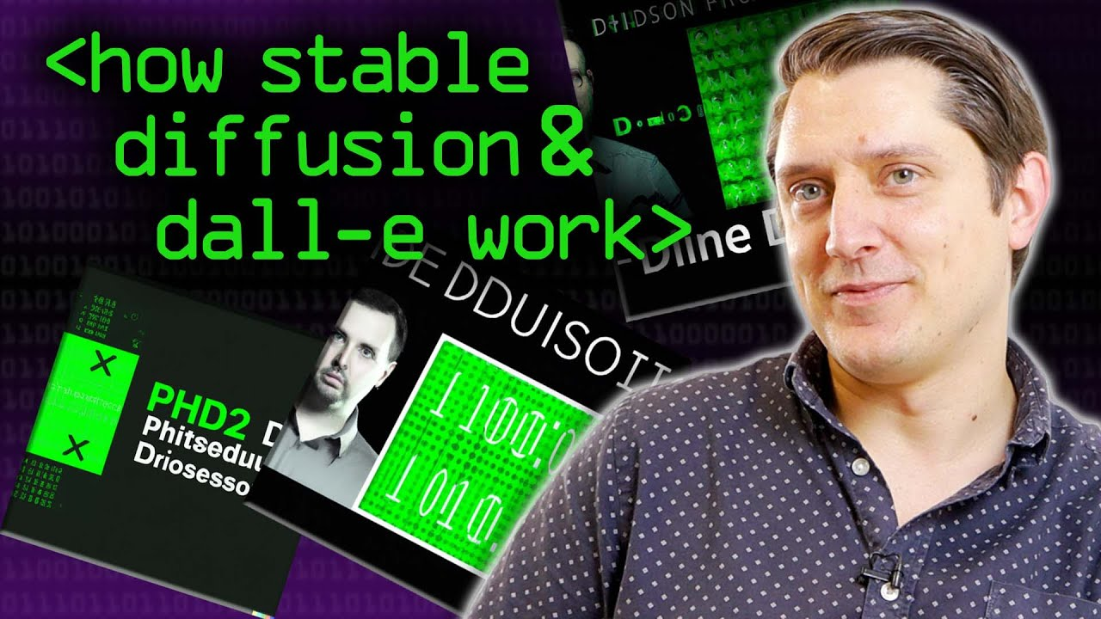
If you ever want to learn how “image or video diffusion” works… (17 minutes, old but good)

Slide 112
Appendix 5: Video

Slide 113
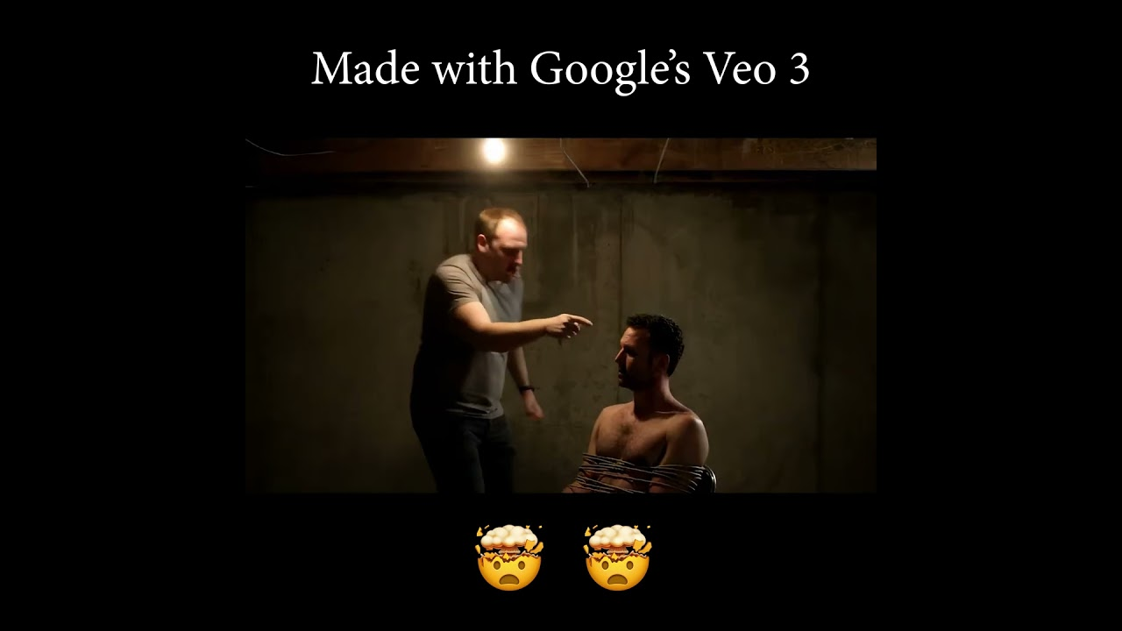
Video
May 23, 2025
  Google launched a text-to-video generation model called Veo that went viral for surrealist existentialism

Slide 114
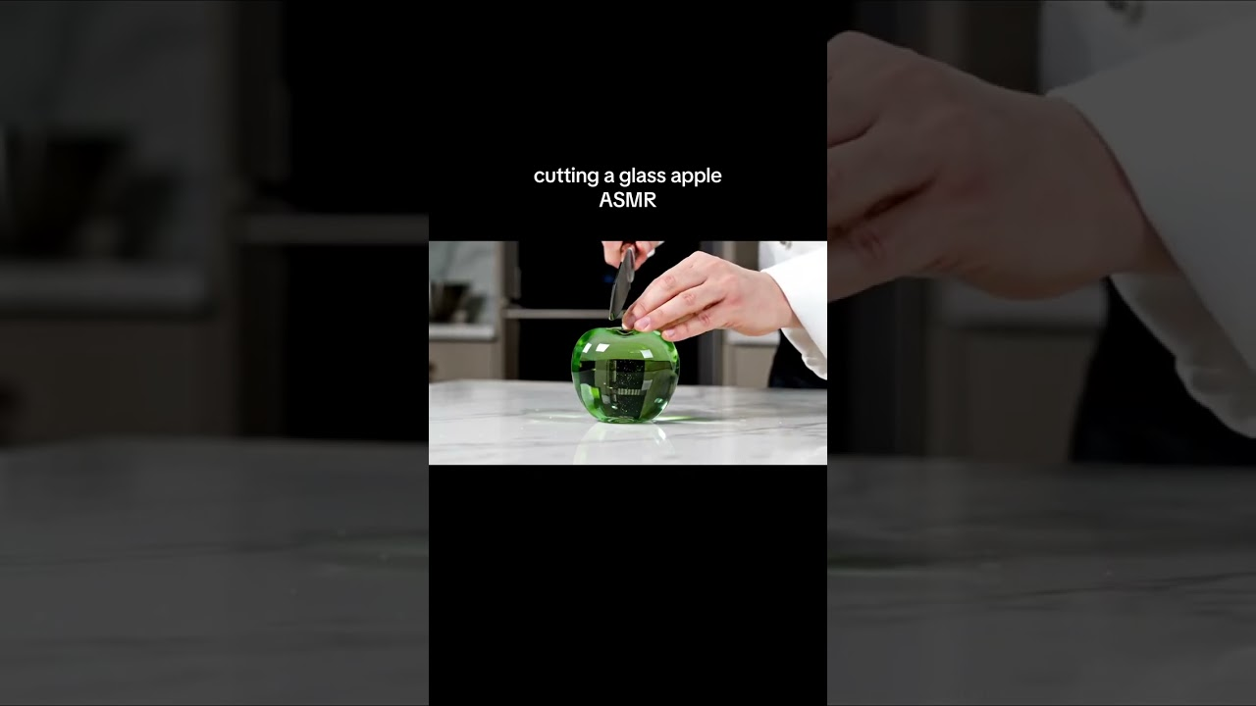
And ASMR videos of knives cutting frozen glass fruits (But first… we meme)

Slide 115
June 6, 2025 - SERIOUS NOTE RE “DISPOSABLE VIDEO” AND EASE
  Andrej Karpathy, one of the leading minds in artificial intelligence, made the point that video is now so easy to create that people can start using gradient descent tricks to maximize engagement or other metrics. We might end up with even more addictive content than our current social media platform algorithms deliver.
  Think of SEO… now think of personal videos to hit every single type of person…
    Not just a video of how to make salsa…
      Every ethnicity making salsa…
      Every language making salsa…
      Every location making salsa (beach in the window, farm in the window)
      Every type of kitchen (wooden, steel, marble, travertine, modern, rustic)
  AI video generation company Runway partnered with AMC networks for video production.

Slide 116

July 18, 2025
  Runway launched a video motion capture feature that doesn’t need greenscreens and can map any motion to animate an image (nothing is real in this video)
python3 eml-to-text.py
python3 rundown.py

Slide 117

August 2, 2025
  Runway launched Aleph, which is an incredible video editor. Hyper-realistic.

Slide 118
If we think oversaturated high dynamic range is a temptation for real estate videos…
https://x.com/runwayml/status/1951345545483579704
https://x.com/runwayml/status/1950903868499337578

Slide 119
Appendix 6: Multimodal

Slide 120
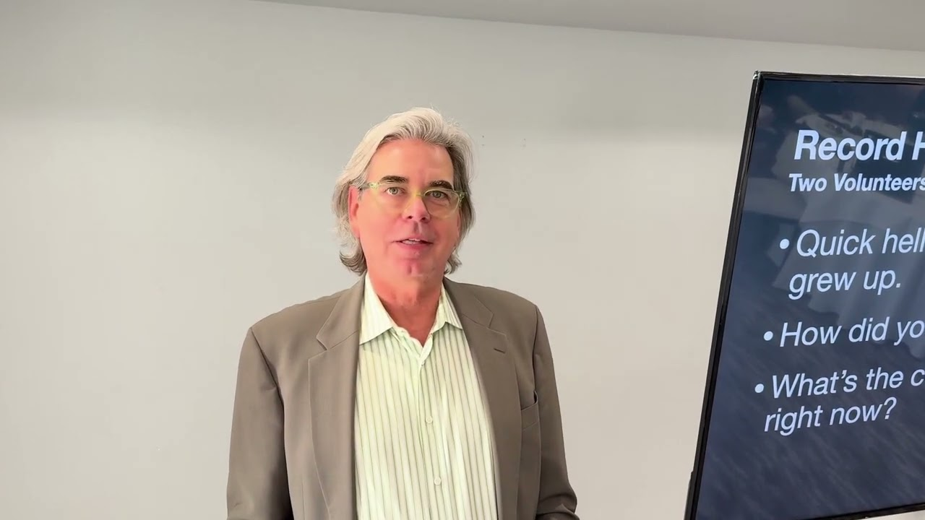
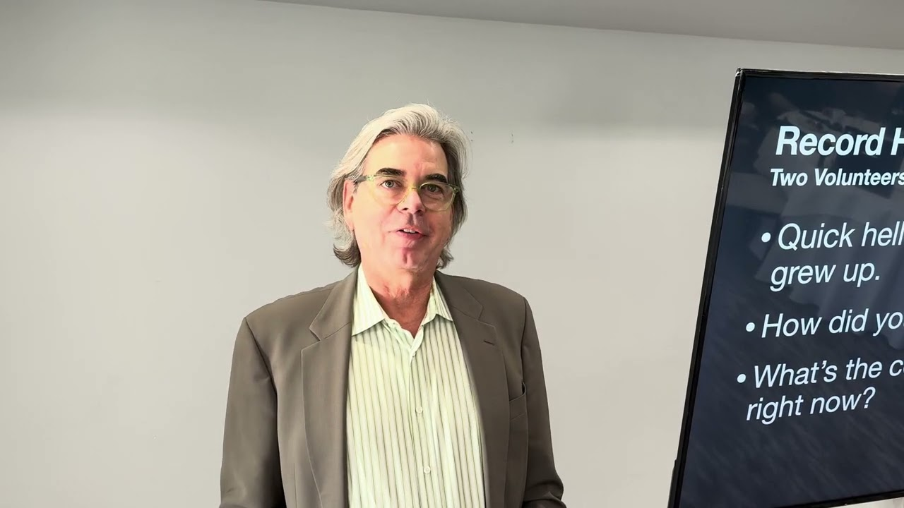
HeyGen demo from a real estate presentation
Switched their language (click to watch each video)

Slide 121
Multimodality
March 7, 2025
  Microsoft’s Phi-4 Multimodal Takes Top Spot in Speech Recognition (OpenSource)
  Sesame Launches Voice AI That Rivals Human Interaction
March 21, 2025
  OpenAI has released three advanced audio models, which include text-to-speech and speech-to-text with better transcription
March 28. 2025
  Researchers developed an AI model that can identify endometrial cancer in tissue samples with a 99.2% accuracy rate. This is significantly better than the current best-in-class methods which are at 80%.
April 11, 2025
  Google has integrated vision into its AI tools, finally catching up to OpenAI’s multimodal product.
  Audio leader ElevenLabs has adopted Anthropic’s model context protocol (MCP) to enable locally running servers to create voice agents to make outbound calls and clone voices.

Slide 122

Let’s try it!
https://www.facebook.com/photo.php?fbid=702461572763982&set=pb.100090004377401.-2207520000&type=3
April 18, 2025
  OpenAI o3 is getting rave reviews. In particular, it can combine every single ChatGPT tool, including web search, Python coding, visual analysis, and image generation. It’s exceptional with math and coding, and has a more natural conversational style.
  Google has announced a model that is going to attempt to talk with dolphins.
  Anthropic is coming out with a voice feature to compete with OpenAI.
  Meta released two open-weight vision models.
  AI can now find a location using only a single photo with no attached metadata.
Also, someone text me a picture of something outside to test.

Slide 123
April 25, 2025
  Microsoft added the ability to “see” to its web browser. It’s also launched computer use and web browsing within the operating system.
May 9, 2025
  OpenAI’s o3 analyzed a Harvard Business School case study PDF, extracted scattered financial data and built a business model comparable to an MBA student.
May 16, 2025
  Amazon launched Nova Sonic, that can have natural back-and-forth conversations in real time. Sounds like Alexa wants to drink Siri’s milkshake.
June 6, 2025
  The FDA approved the first AI tool to predict breast cancer risk from mammograms.
June 14, 2025
  Meta released a robot training system that learns how the physical world works by watching videos, similar to children developing intuitions by watching the world.
  Instagram is testing features that convert static photos into a 3-D images.
  OpenAI updated their voice mode to be a lot more expressive. You can ask the voice to sound nervous, excited, or jittery, and the new voice features can capture those emotions.

Slide 124
June 20, 2025
  OpenAI rolled out a record mode for ChatGPT and can capture meetings and voice notes.
June 27, 2025
  Amazon Ring launched video descriptions where your security camera simply tells you what’s happening outside so you don’t need to look at the camera. It could email you what happened or describe it out loud as it happens. “A guy drove up in a UPS truck and put a box on your front steps.” “A woman is at the door with a dog on a leash and keeps looking into the window.” Etc.
  A few months ago, Google DeepMind released a tool called VideoPrism that is suddenly gaining attention. VideoPrism can watch a video and provide deep context and details about every frame, a task that would be virtually impossible for a human to accomplish. Think real estate, legal discovery, etc…
    https://research.google/blog/videoprism-a-foundational-visual-encoder-for-video-understanding/ <- Quick look at it in action

Slide 125
June 27, 2025 (continued)
  Alibaba developed a system that can identify gastric cancer from standard CT scans with greater accuracy than doctors. China has already deployed the system and screened over 78,000 patients!
  Google also launched an update of their Gemma model which is designed to run locally on smart phones and edge devices. Gemma provides multimodal AI capabilities without any Internet connection. In addition to being able to understand text, images, audio, and video, the model can handle translation and is open source.
  Google DeepMind released an AI system called AlphaGenome that predicts how genetic variations affect biological processes and can analyze DNA sequences up to 1 million letters long.
July 4, 2025
  Researchers have developed an artificial intelligence system that can detect Parkinson’s disease by analyzing short videos of people smiling, achieving 88% accuracy.
  Mayo Clinic researchers have created an artificial intelligence tool that can identify nine different types of dementia from a single brain scan.

Slide 126
July 4, 2025
  Microsoft researchers developed an AI diagnostic system that correctly solved 85% of complex medical cases from the New England Journal of Medicine compared to just 20% accuracy achieved by experienced physicians.
  The Olympics are implementing artificial intelligence across quite a few areas of the coming winter Olympics.
    Broadcast partners during the last Olympic games used AI to transform 11,000 hours of footage into 97,000 highlight clips.
    Alibaba and Omega are using depth and segmentation (two great terms to know!) to track athlete movements and give biomechanical analysis.
  ElevenLabs released a new tool that creates custom synthetic voices that are extremely dynamic and might be putting the voiceover professional out of work. These are worth checking out as they are very dynamic and have the ability to be guided to match the timbre and enthusiasm of the script.
  Andrej Karpathy a great point that local models are making significant inroads and will soon be the bridge between devices in the cloud, small models can process text, images, and audio offline, and then hook into external tools as needed.

Slide 127
July 4, 2025 (continued)
  Nvidia released an 8 billion parameter vision model designed for document processing and character recognition. This can extract and understand information from complex documents, PDFs, images, tables, charts, formulas, and diagrams. This will lead to automating workflows in finance healthcare and law firms. These models will also help with invoice processing and compliance.
  Google released a hurricane forecasting model for with long-term forecasting… up to two weeks ahead of a storm.
July 18, 2025
  ChatGPT is on track to edit and understand Excel and PowerPoint within chats, without opening Microsoft Office.
July 25, 2025
  Meta released a dataset of 4,000+ videos of face-to-face conversations and over 65,000 social interactions with full annotations to help models learn and emulate behavior.
  Google DeepMind released an AI tool called Aeneas that will help historians interpret fragments of Latin inscriptions.
August 8, 2025
  Google released a world simulation model that creates entire explorable 3D worlds with just a prompt.

Slide 128
In February, We Ran A Perplexity Deep Research Demo
“I'd like to get a recommendation on a home to purchase in Sussex County Delaware for $750,000 or less. I'd like to try to identify the best value for that price that I could hold onto and resell and I'd like to find the strongest realtor in the area to represent me as a buyer.”
https://www.perplexity.ai/
Results: https://www.perplexity.ai/search/i-d-like-to-get-a-recommendati-TQBjHA63Qc.fehbgIGf4hA
Since February EVERY model now has a research agent… if you’re not using deep research you are missing opportunities in any subject!
I use it dozens of times per day for my entire family. Incessantly.

Slide 129
Appendix 7: Agents

Slide 130
Consumers are using agents to reach out to companies.
Companies are building agents to answer consumers.

Slide 131
Agents
March 7, 2025
  OpenAI Plans Premium AI “Agents” with Monthly Fees Up to $20,000
  Amazon Developing AI Reasoning Model Under Nova Brand
  AI financial analyst Endex emerges from stealth with OpenAI partnership
  Adam Silverman Predicts UI Design Will Shift From Human to Agent Experience
March 14, 2025
  OpenAI is pushing the pace of agent adoption (AIs that can take action on your behalf) with the addition of commands that can help developers build agents that can search the web, look through local files, and even control your computer.
  Legal AI provider, Harvey, has built agents that are outperforming humans at law firms.
    https://x.com/harvey/status/1899491666429632907 <-Watch this later!
  Another breakthrough product comes out of China called Manus, with building hype coming off of the previous week’s announcement. This is a product that is built on top of Anthropic’s Claude that has 29 additional agent tools, like browser control. https://manus.im/
  The Pentagon signed a deal to use AI agents for military planning.

Slide 132
March 21 2025
  Nvidia released two open models that allow AI agents to reason.
  Anthropic has given its AI the ability to search the web
  A new study came out that shows that AI agents are doubling their abilities every seven months.
March 28, 2025
  A few months ago, Anthropic released a structured method of allowing AI models to talk to third-party systems. This is called the “Model Context Protocol” or MCP for short. This week OpenAI announced that it would adopt Anthropic’s standard.
  Researchers at Harvard conducted a randomized trial with 776 Procter & Gamble employees and found that a single person can work as well as a two-person team if given AI tools. - THIS MEANS YOU, REALTORS
  A trend in the last two weeks is developers releasing text files with detailed language model instructions in text.
  Lockheed Martin and Google announced an integration of Google’s AI tools into Lockheed’s factory systems.

Slide 133
April 4, 2025
  Amazon released an amazing new model that can perform tasks using web browsers. It has over 90% accuracy.
  Automation tool Zapier has now integrated over 8000 apps with the model context protocol. It may take a few more months for this to trickle down to lay people, but I think automation of tasks is going to be a welcome discovery once it becomes demystified.
April 11, 2025
  Google launched their own open agent protocol that allows agents from different vendors to communicate. At the same time, Google announced they will adopt and support Anthropic’s model context protocol (MCP) agent structure.
  Google released a Deep Research competitor to OpenAI and Perplexity. Thanks to Google’s deep integration with search, Google’s Deep Research is already outperforming PhD-level researchers when given access to the web.
  Adobe plans to integrate AI agents throughout its Creative Cloud product lineup to automate the mundane parts of creative operations as well as improve context-aware search within videos and photos.

Slide 134
April 25, 2025
  Anthropic predicts fully automated AI employees within the next 12 months.
  Along those lines, Microsoft predicts that 2025 will be the year that “frontier firms” emerge and AI employees begin to lead operational tasks.
  Anthropic launched a research feature. This means that Google, OpenAI, Perplexity, Claude, and DeepSeek all now have robust research capabilities. This is also a harbinger for the end of the Internet as we know it.
  ElevenLabs, the audio AI company, has developed a method to allow voice agents to transfer calls to other voice agents. That’s a spectacular development and it implies that different specialists agents could take on different tasks and transfer those tasks, just like humans do now. I would say call centers are soon to be an extinct species.
  A new benchmark has shown that OpenAI’s O3 model can outperform 94 percent of expert virologists.
May 02, 2025
  Yelp began testing AI-powered voice agents to help restaurants and businesses manage incoming phone calls.

Slide 135
May 9, 2025
  Google Gemini’s 2.5 Pro model became the first model to achieve the number one rank across all text, vision, and web dev benchmarks simultaneously. The model can watch videos and convert them into functional web applications. Gemini has such a large memory that it can review 50,000 lines of code (!) at once within a chat window with no problem.
  Former Google CEO Eric Schmitt has a startup called FutureHouse which has built five specialized artificial intelligence agents to help scientists navigate large amounts of data and research.
May 16, 2025
  Google released AlphaEvolve, a strong reasoning agent that found the best human solution to 70% of the toughest known logic problems. It actually went beyond humans, and for 20% of the problems (!), it found a novel solution that no one had thought of before and improved on the best known solution. Google is using this model to self improve its workflow and has been able to achieve 23% efficiency boosts internally.
  OpenAI’s latest models are exceeding human doctors across standard medical knowledge tests. Six months ago, “AI plus humans” were the best at the test but now “AI without humans” is the best.

Slide 136
May 23, 2025
  Microsoft launched a science agent which discovered a new material in a few hours. Not only was the new material discovered, but scientists were able to synthesize the compound in the laboratory.
May 30, 2025
  OpenAI went on the record that they plan to launch a super assistant in the first half of 2025.
  Doctors at Harvard and Stanford benchmarked OpenAI’s o1 preview model and reconfirmed it displayed superhuman diagnostics and reasoning in medicine.
June 20, 2025
  Microsoft released an upgrade to its assistant that can see and analyze what’s on your computer screen to give real-time guidance or directions to troubleshoot or modify settings and use software.
  The UK deployed a system called Extract that converts complex planning documents, including handwritten notes and blurry maps, into digital data within 40 seconds.
  Japan’s largest bank partnered with AI company Sakana to automate banking document creation.

Slide 137
June 20, 2025 (continued)
  Russia’s Sberbank announced plans to create their own AI system with advanced reasoning capabilities.
  Salesforce released a marketing suite of tools that can handle routine marketing tasks like building audience segments, writing email copy, and managing ad performance. These agents can work independently or assist marketing managers, and take directions like building a campaign or creating personalized offers.
  A model specifically trained for medical use can answer questions as well as human physicians on healthcare benchmarks. What’s really wild about this model is that it is 70% smaller than most models and can run on a laptop locally. We’re getting to the point where everyone will be able to have a physician in their pocket without even being connected to the cloud.

Slide 138
June 27, 2025
  Legal AI software company Harvey released a demonstration of their latest workflow tool, which essentially chopped the bottom out of legal work and would terrify me if I were a student in law school.
  OpenAI added both document editing and chat to ChatGPT, which directly competes against Microsoft Office and Google Docs
  Microsoft announced a very small model that can run locally on a PC to help users change system settings, using natural language… basically like Alexa for your laptop settings.
July 4, 2025
  A legal AI assistant company called Legora made the radar this week with an introduction of a product called workflows (the same exact name as the product from competing firm Harvey). This allows the automation of due diligence document analysis and legal research using natural language commands. It seems like a harbinger of the end of the paralegal era.
  Writing assistant company Grammarly is acquiring email automation provider Superhuman to combine writing assistance with email management for automating transactional communication. (real estate, law, accounting, sales)

Slide 139
July 11, 2025
  A new tool trained to work on Excel spreadsheets is able to achieve a score of 80% on the Excel World Championship test in only 10 minutes. That is 10 times faster than a human.
July 18, 2025
  Anthropic launched an enterprise solution for major financial data providers. Norway’s sovereign wealth fund beta tested it and reported a 20% efficiency boost, equivalent to 213,000 saved hours. AIG sped up their underwriting time by 5x and improved data accuracy from 75% to 90%.
  OpenAI launched an agent designed for investment banking. It’s specifically made to analyze financial documents and create pitch decks and can also help with valuations and due diligence. Beta testers reported up to 70% reductions in document prep time.
  Andrej Karpathy mused that if AI becomes the main consumer of data and research papers, the format and language might become compressed or shifted to accommodate the efficiency of an LLM as a reader. - WHAT DOES THIS MEAN FOR REAL ESTATE SEARCH IF THE USERS ARE AI BOTS AND NOT PEOPLE?

Slide 140
July 25, 2025
  Multiple models threw their hat into the ring of the recent International Mathematics Olympiad, a world class high school math competition.
    Google Gemini and OpenAI both achieved gold medals in the math competition.
August 8, 2025
  Google launched Gemini DeepThink which is a consumer version of the thinking engine used to win the International Math Olympiad recently.
  Singapore start-up Manus announced Wide Research which empowers multiple agents across multiple models (as a wrapper). It’s supposedly incredibly powerful for dauntingly scaled tasks like researching all Fortune 100 companies at the same time.
  Andreessen Horowitz is backing voice agent platform, EliseAI, which makes AI voice agents for property management, and healthcare, at a $2B valuation!
  ElevenLabs announced their redesigned interface for AI voice conversation agents.
  Shopify continues to roll out conversational commerce agents.

Slide 141
Appendix 8: Future of the Internet

Slide 142
“The ‘content’ of any medium is always another medium. The content of writing is speech, just as the written word is the content of print, and print is the content of the telegraph.” – Marshall McLuhan 1964

Slide 143
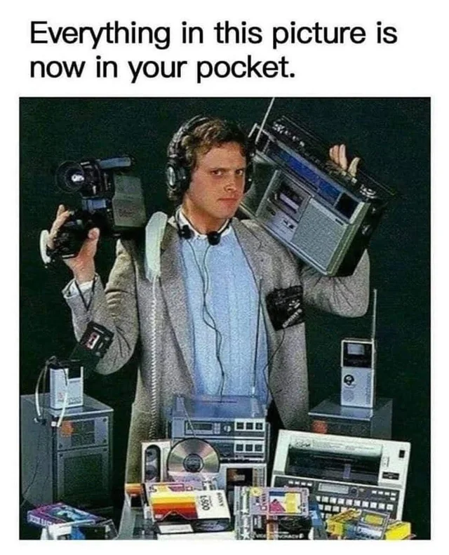
Each new medium both contains and can emulate the mediums it replaces. The internet contains and emulates film, radio, television, publishing, and retail.
The content of AI will include… the Internet.

Slide 144
Browsers, SEO and Publishing
February 28, 2025
  New Alexa powered by Claude
  Perplexity planning AI browser (Comet)
March 7, 2025
  Apple may be preparing Gemini integration in Apple Intelligence
  Perplexity Launches Enterprise File Integration
March 21, 2025
  Payment processing provider Stripe has created a template to allow companies to share transaction documentation with AI agents. Never leave the chat!
April 18, 2025
  It’s rumored that OpenAI is creating a social media platform
  A company called Firecrawl has released a web scraper that can navigate complex websites and fill out forms.

Slide 145
April 25, 2025
  Google announced that its AI-enhanced search now reaches 1.5 billion users per month.
  A study showed that these AI overviews reduce click-through rates by 34%.
  Andrej Karpathy, one of the most generous, smartest, kindest, and broad-visioned voices in AI (and I don’t say that lightly), co-founder of OpenAI and former head of AI at Tesla, has said that our primary audience as product developers, publishers, and e-commerce website developers is no longer human. Instead, our primary audience is going to be web crawlers and agents that are looking on behalf of people who have asked them questions. WHAT IS A LISTING THEN?
  OpenAI has expressed interest in purchasing the Google Chrome browser, if given the chance.
  The Washington Post has partnered with OpenAI to include news within ChatGPT chats.
  Adobe has now incorporated Google and OpenAI’s models into its Firefly product.
May 02, 2025
  OpenAI rolled out enhanced ChatGPT shopping.
  Mastercard and Visa also separately introduced AI agent integration into their payment systems to automate AI purchasing.

Slide 146
May 9, 2025
  Both OpenAI and Google have integrated shopping capabilities into their AI features. Big change is coming for retailers (and affiliate models) this year.
  Anthropic has integrated web searching into both its chat model and the API. This is yet another shift in the publishing landscape and the internet itself, as models search the Internet and retrieve information without leaving the chat.
  Apple plans to add artificial intelligence search options to its web browser, Safari.
  LinkedIn added AI powered job searching which supposedly allows users to search for jobs using plain language descriptions. Zillow did this over a year ago with plain language home searches.

Slide 147
May 23, 2025
  If agents weren’t enough, interfaces are officially beginning to be disrupted. OpenAI acquired Apple designer Jony Ive’s company for $6.5 billion. The rumor is they are going to build a device that has no graphical user interface.
  Google has launched an Internet agent that can manage up to 10 web-based tasks at the same time, including things like booking flights or making restaurant reservations. Even with a web interface like a browser, if the system takes a search query and goes out throughout the entire Internet to accommodate requests, that implies it might as well be a non-graphical interface. You just ask Google what you want and Chrome goes and does it.
  Google’s Internet agent can save tasks to repeat on a regular basis. For example, if you want to check real estate listings, instead of opening the apps, Google will check them every day for you and even schedule viewings of properties.
    https://x.com/Google/status/1924877428997939563 <- In MAY.
  AI search tool Perplexity reports that people are booking hotels directly through its AI search platform more and more every day. Hotel advertising is Google’s second-largest category.

Slide 148
May 30, 2025
  A startup called the Browser Company announced that they were building a web browser that was chat interface-based as opposed to page-based. The press release bluntly said that web browsers will die.
  The CEO of Perplexity predicts that AI agents will decimate Google search volume and shift traditional cost per click budgets to AI integration.
  Perplexity released a new feature called Labs, which is a powerful search mode that handles complex projects like building dashboards or mini applications. Labs supports interactive tool use beyond basic web searching. For example, creating financial reports from more than one source, aggregating findings, and creating charts and visualizations.
  Microsoft announced a commitment to “The Agentic Web,” where AI programs team up and collaborate to go out on the Internet on our behalf so we no longer have to browse. - - - THIS IS HAPPENING.

Slide 149
June 06, 2025
  Meta plans to fully automate their advertising tools by 2026 using artificial intelligence. Completely cutting out the creative process and middle persons.
  Opera released a browser called Neon that uses AI agents to automatically complete tasks like filling out forms or booking trips while users browse the web.
  H Company introduced web automation agents that are able to read, click, and type on websites with 92% accuracy.
  Firecrawl launched a hosted service that connects web scraping abilities directly to the large frontier models. (Savvy people will create tools to compete with you)
June 14, 2025
  Google started to roll out data visualization features in their AI search results that automatically create interactive graphs for stock and mutual fund queries. These visualizations are built on the fly using Gemini’s reasoning capabilities to build whatever charts or graphs “Google thinks” best fits the data question. This is bigger than it might initially seem as user interfaces will suddenly just appear in front of us rather than being built in advance.
  Perplexity has launched an AI browser called Comet that appears to be gaining loyalty among power users. It integrates with browser history and can read emails and attempts to think ahead of people’s intentions… you just confirm as you go.

Slide 150
July 18, 2025
  OpenAI launched “Agent” which combines web browsing, deep research, coding, and file manipulation. I’ve been using it for two weeks (I’m behind on my newsletter, so this is being written post-launch). It’s wild to watch Agent open a small window inside the chat, where it opens websites and navigates my emails, logs into LinkedIn, and creates spreadsheets and Google docs.
  Google is adding AI features into search and Chrome. There’s now an option to have AI call a business on your behalf (we predicted via Simple.ai this spring). That was faster than I expected.
August 2, 2025
  Google’s AI overviews reached 2 billion monthly users (up from 1.5 in April)

