Slide 1
AI Trends and Fun Demos
Ethan Holland
February 25, 2025

Slide 2
About me

Slide 3
30 Years Transforming Legacy
Companies -> Digital

Slide 4
Burpee Seed Catalog
Print -> eCommerce

Slide 5
Jewelry Television
Home Shopping -> eCommerce

Slide 6
American Eagle Outfitters
Mall Retail -> eCommerce

Slide 7
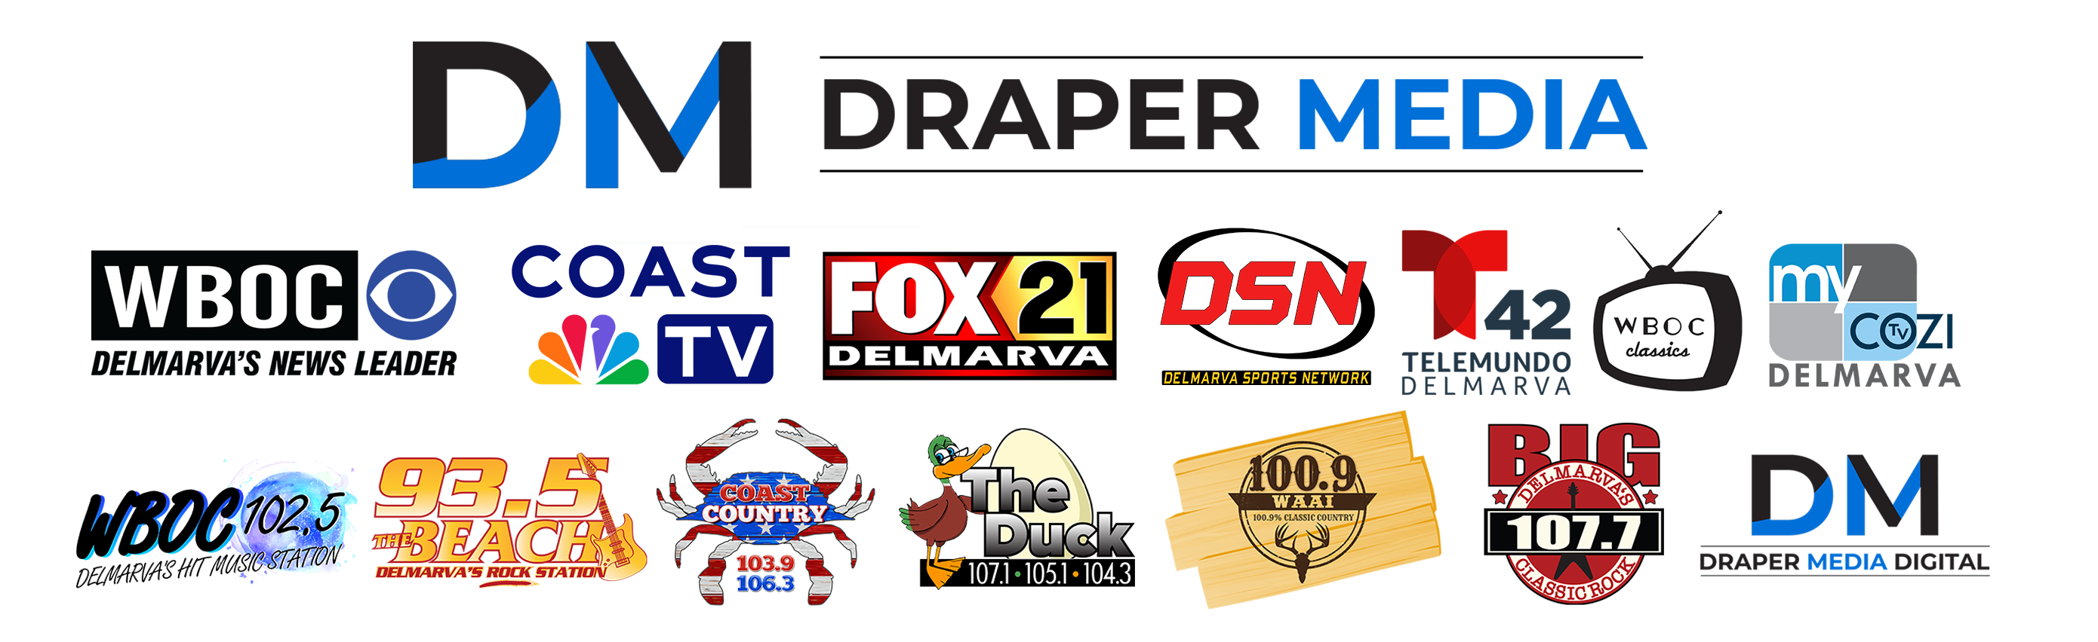
Broadcast TV and Radio - VP Digital
VP Draper Digital Media

Slide 8


Slide 9
English Literature Major
No Computer Science Courses

Slide 10
Fun Adventures Along The Way
In My Career

Slide 11
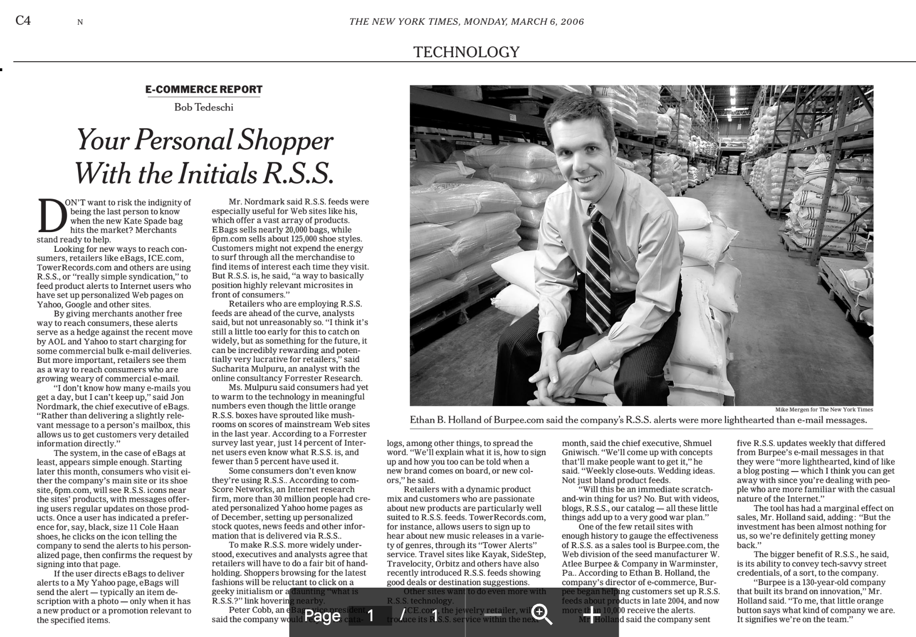

Slide 12
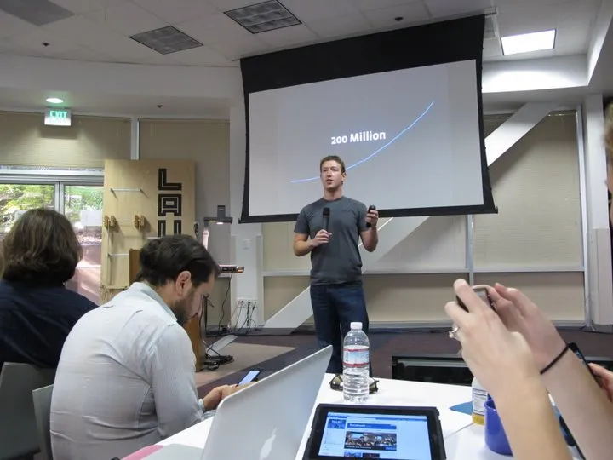
Meetings with Mark Zuckerberg

Slide 13
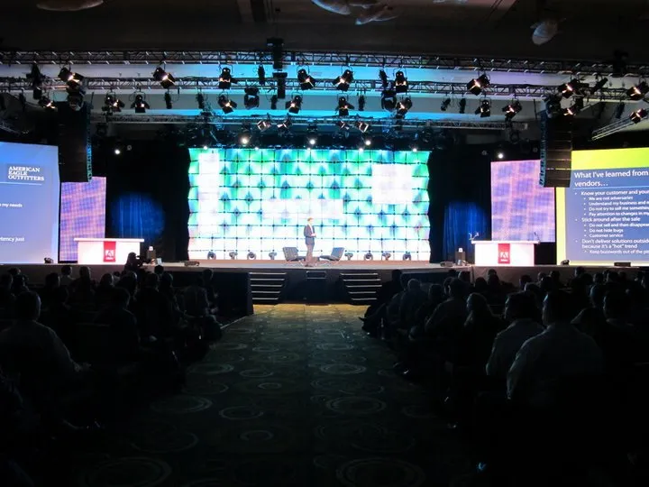
Keynote speaker at Adobe’s worldwide sales conference

Slide 14
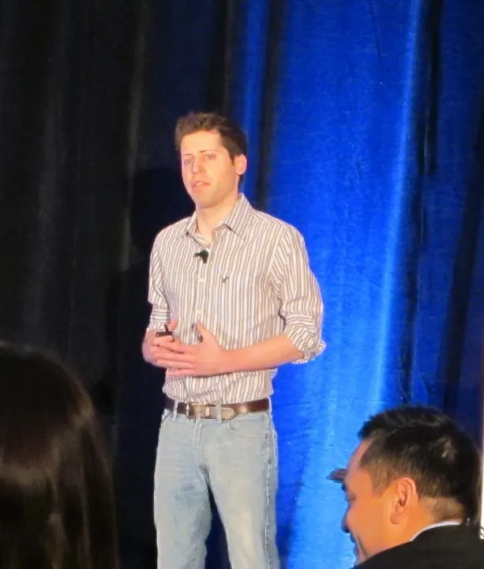
Presented with Sam Altman (long before OpenAI)

Slide 15
Today I’m Simply Myself
Nerdy Friend of Kathleen Schell
Obsessive AI Enthusiast!

Slide 16
We’re going to have some FUN talking about AI

Slide 17
November 30, 2022
Chat GPT launched

Slide 18
I made a decision to be the most informed person in the room.
Even if it meant “getting weird”

Slide 19
Started privately tracking the AI news each week.
Started privately tracking the news.

Slide 20
Sept 2023: Presented on AI to the National Association of Broadcasters
NAB Presentation Link

Slide 21
October 2023 - “Use it or it didn’t happen”
Made a commitment to automate sharing everything I learned… even if I looked foolish or failed.

Slide 22
Launched a weekly AI news blog
Took 54 hours of work to publish one week of AI news
Information mining, clicking, opening, sorting…
https://ethanbholland.com/category/this-week-in-ai/

Slide 23
Struggled to keep up.
Was six weeks behind for 10 months.
Slowly automated everything.

Slide 24
22 Python scripts
3 Chrome extensions
WordPress API
Adobe Photoshop Scripts
Google Apps Scripts

Slide 25
Now my blog takes only the time needed to read the headlines.
And 15 min/week to post them.

Slide 26
Every weekend, I review and publish 300-600 AI headlines.

Slide 27
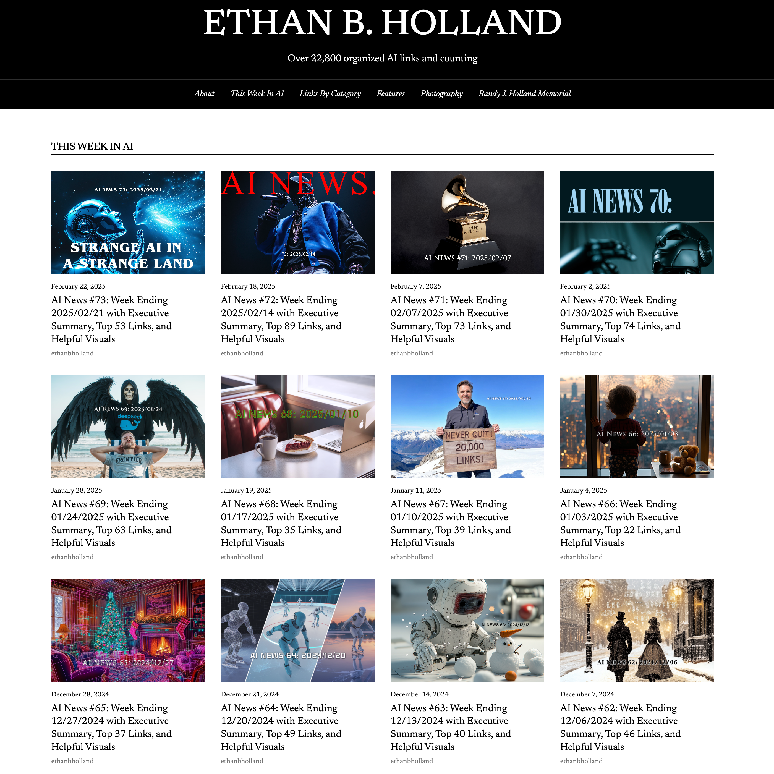
73 weeks. 22,800 links.

Slide 28
English Literature Major
No Computer Science Courses

Slide 29
Today I’m going to talk about four AI trends I’m seeing… right now

Slide 30
As we start, here are three guiding principles:

Slide 31
THE SUM is greater than the parts.
Think about how the things we see today will connect.

Slide 32
Always be aware of your mental timetable:
Short term
Mid term
Long term
Otherwise it causes chaos when trying to talk about AI

Slide 33
When possible, use the tool name or technology, not simply “AI”
GPT4, o3, Sonnet 3.7, Grok 3, Llama 4, Mistral, ElevenLabs, HeyGen, Flux, MidJourney, Mistral, Deepseek, Runway, Kling, Viggle, NeRFs, LivePortrait, Gaussian Splats, Diffusion,…

Slide 34
Four AI Trends to Know

Slide 35
Trend One: Basic Generative AI
Traditional Chat
Image generation
Video creation
WE’RE SKIPPING THIS

Slide 36
Trend TWO: Multimodality
Interacting with AI using audio, images, or video

Slide 37
ChatGPT Voice
Switch to screen share and index cards
https://openai.com/index/chatgpt-can-now-see-hear-and-speak/
Talk with me about the presentation
Screen share and browse the web
Look around the room
Talk about the people
Give me a description of the room for a real estate listing
Do it in Spanish. French. German.
Show a math problem and explain it in a realty example

Slide 38
Multimodal AI actually understands the sound waves of my voice as audio and does not convert them into text. That’s what most people don’t realize…just as you hear and understand sound, it understands sound rather than transcribing it.

Slide 39
Record HeyGen Demo Video:
Two Volunteers - Male/Female
Quick hello tell us your name and where you grew up.
How did you get into real estate?
What’s the coolest property you have for sale right now?

Slide 40
AirDrop and Upload
Demo 1: Before
Demo 2: French
Demo 2: Before
Demo 2: Portuguese

Slide 41
ElevenLabs Audio Cloning

Slide 42
Our peers are using AI
We do not always know it.

Slide 43
Telemundo - Fall 2023
Translation with voice over
https://www.youtube.com/watch?v=51oWEqXlmas

Slide 44
CoastTV Salutes - July 2023
Two Voices… which is AI?
https://youtu.be/vU_T4sWc1oY?si=PMczVadb-JYFBJw7

Slide 45
Both examples are employees being enterprising on their own.

Slide 46
Trend THREE: Agency
AI taking actions on your behalf
Language is an interface

Slide 47
Perplexity Deep Research Demo
“I'd like to get a recommendation on a home to purchase in Sussex County Delaware for $750,000 or less. I'd like to try to identify the best value for that price that I could hold onto and resell and I'd like to find the strongest realtor in the area to represent me as a buyer.”
https://www.perplexity.ai/
Backup: https://www.perplexity.ai/search/i-d-like-to-get-a-recommendati-TQBjHA63Qc.fehbgIGf4hA

Slide 48
Simple.ai <-LINK
Demo with Kathleen
Audience help: Write down five things we want to find out from Kathleen on index cards
Switch to app view

Slide 49
Companies are building business agents that answer the phone.
Vendors are including secret handshakes so two agents know when an agent is calling another agent

Slide 50
Boardy.ai <-LINK
I need another volunteer!
Someone with a few hobbies and other interests.
Switch to phone view. Call Boardy!

Slide 51
Boardy shows what happens when you put a language layer on top of a large database like LinkedIn.
Imagine if you could talk to real estate listings in the same way?

Slide 52
Check on HeyGen progress

Slide 53
Trend FOUR: Co-Pilots
Working with AI to write code.

Slide 54
Demonstrate Twitter Opener
11 Twitter accounts filtered by a date range sorted to chronological minus replies
Open all the tweets in a new tab
Save all of the open tabs to a text file

Slide 55
Mortgage preapproval agent
Bear with the 2x voice speed!
https://x.com/AtomSilverman/status/1891965335169008133

Slide 56
Trend FIVE: Computer Use
AI operates a computer or phone autonomously for a user

Slide 57
Remember the SUM is greater than the parts…?
MULTIMODAL AI can be trained to understand interfaces and see websites or files the way we see them.
AI AGENTS can click on buttons and navigate websites. Download files open apps.
NEW TERM: A Large Action Model is specifically trained on actions using structured and labeled user interfaces and reinforcement learning

Slide 58
In the future, one person can have multiple agents taking actions at the same time

Slide 59
Oct 2024: ANTHROPIC
https://www.anthropic.com/news/3-5-models-and-computer-use
January 2025: OPEN AI
https://openai.com/index/introducing-operator/
December 2023(!): APPLE
Apple has had a large action model for over a year that can interact with any app on your phone without opening your phone
I think Apple understands that this will disrupt the App Store so they're not releasing it at once
https://arxiv.org/pdf/2404.05719

Slide 60
Trends Recap
1) Multimodality https://ethanbholland.com/category/ai/multimodal/
2) Agency https://ethanbholland.com/category/ai/agents-and-copilots/
3) Copilots
4) Computer Usage

Slide 61
One trend we skipped:
Robotic Embodiment
It’s my favorite of the trends.
But we have to skip it for today.
https://ethanbholland.com/category/ai/robotics-embodiment/

Slide 62
The 70% Expert Concept

Slide 63
One year ago, the rule of thumb was that a frontier model was a 70% expert in any given subject.
So as a realtor if you're better than a 70% expert, you're going to be disappointed.
But as a 0% Hungarian speaker, you’re going to be amazed.

Slide 64
Now the rule of thumb is that frontier AI is a PhD level expert in any given subject.
Combine today’s trends - agency, multimodality, and the ability to use computers…
You can see that whether it's one year or five years the world is going to change quickly,

Slide 65
What Is Going to Happen?
“The ‘content’ of any medium is always another medium. The content of writing is speech, just as the written word is the content of print, and print is the content of the telegraph.” – Marshall McLuhan 1964

Slide 66
Each new medium both contains and can emulate the mediums it replaces. The internet contains and emulates film, radio, television, publishing, and retail.
The content of AI will include… the Internet.

Slide 67
Everyone will have PhD-level assistants in every subject at their fingertips or voice… with the ability to take automated actions

Slide 68
What will happen to apps? Keyboards? Browsers? Seach engines?
….Property listings?

Slide 69
What is the future of the real estate (or any job) in this world?

Slide 70
Short term: Rumblings and doubt
Mid term: People adopting tech win
Long term: Internet-level/unimaginable disruption and change

Slide 71
NOW: Q&A if time allows
You can follow my blog at
ETHANBHOLLAND.COM
Thank you!

